Slide 1

Megaminx
MMR 2020 – Group 3

Slide 2
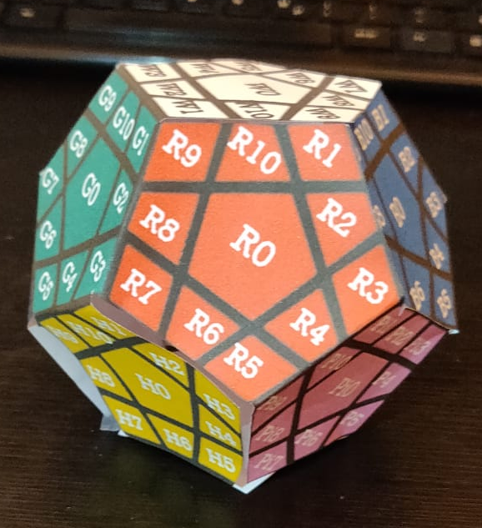
Beginning Position
u
Allowed Moves:
Up
Right
Front
Left
l
r
f
dl
dr

Slide 3
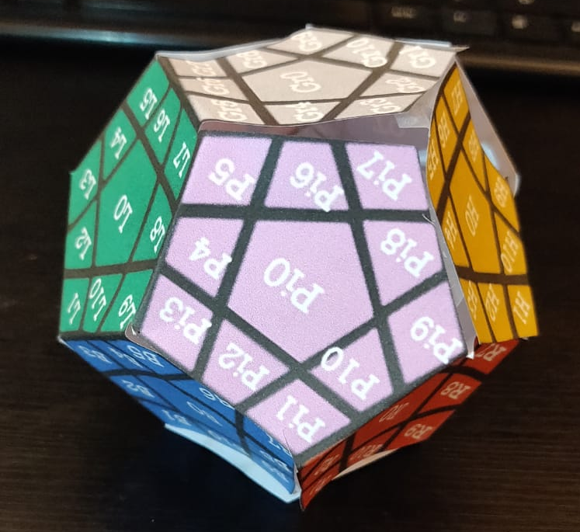
Axis Rotations
r_v
r_ud (upside down)

Slide 4
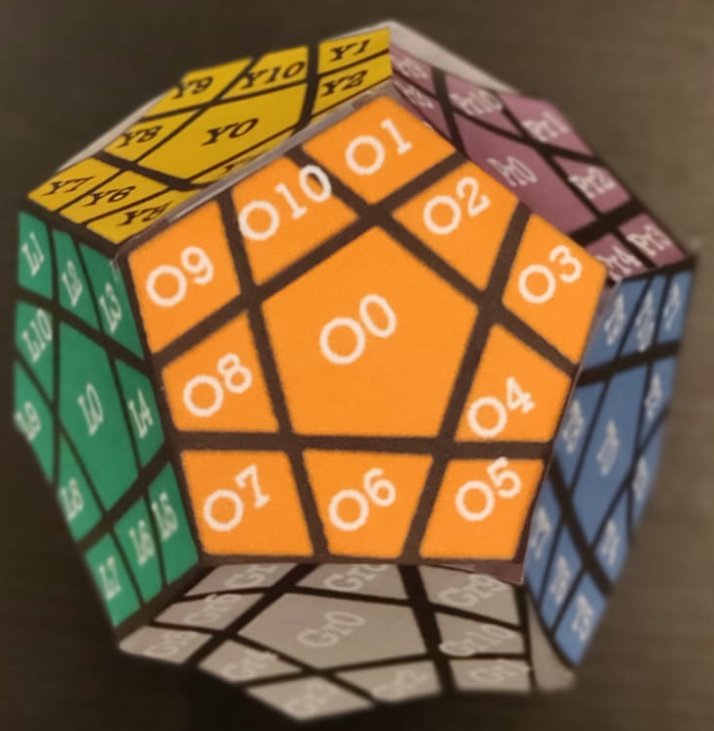
Numeration Method
u
br
bl
r
l
b
f
bdl
bdr
dl
dr
d

Slide 5
Numeration Method
u
br
bl
r
l
b
f
bdl
bdr
dl
dr
d

Slide 6
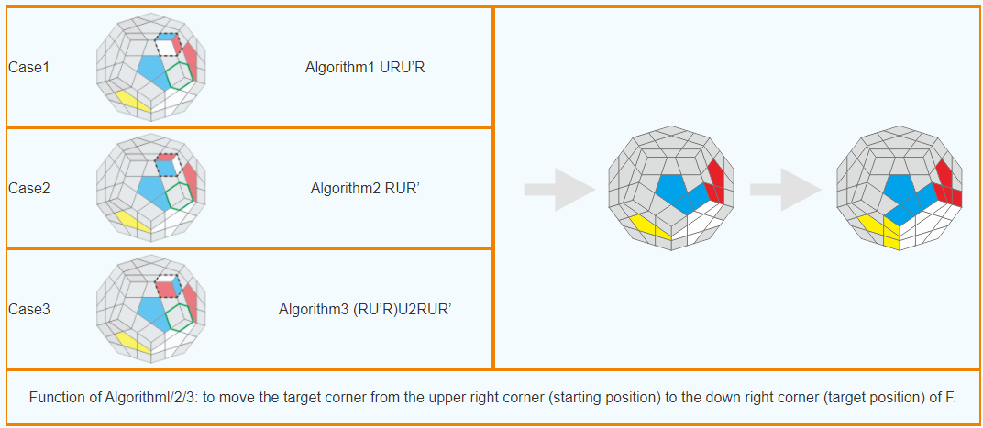
ALGORITHMS
SP1
l dl l‘

Slide 7
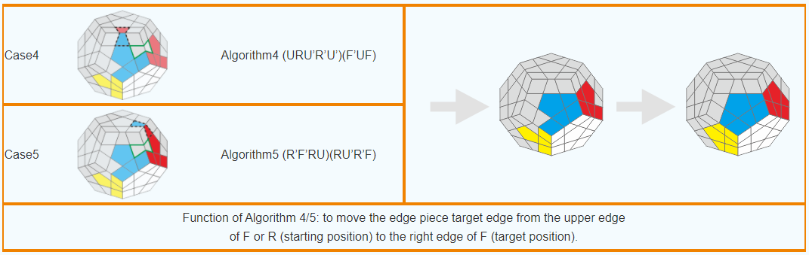
ALGORITHMS
SP2
(dl l dl‘ l‘ dl‘) (f‘ dl f)

Slide 8
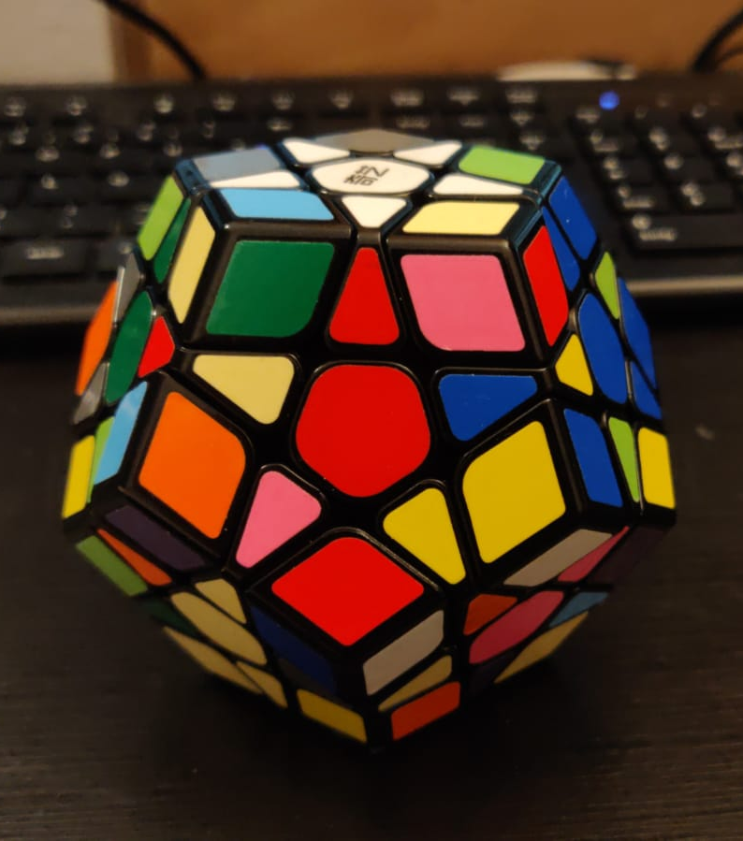
Goals
Goal 1

Slide 9
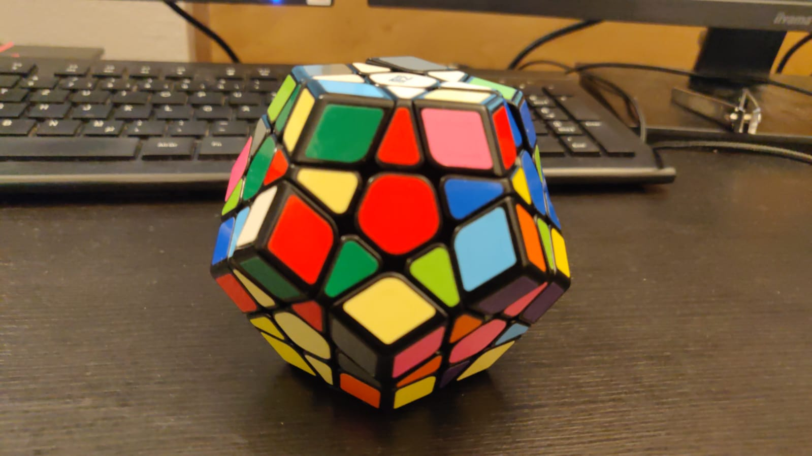
Goals
Goal 2

Slide 10
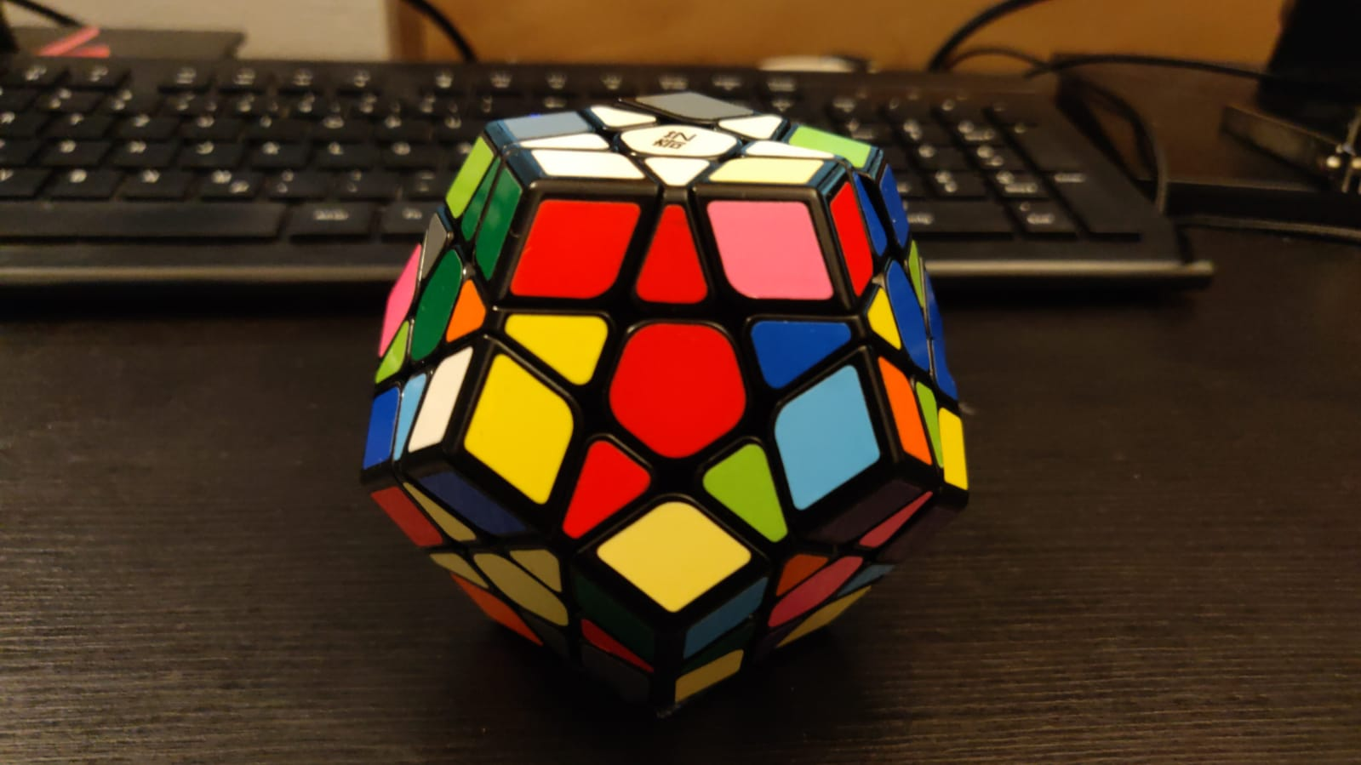
Goals
Goal 3

Slide 11
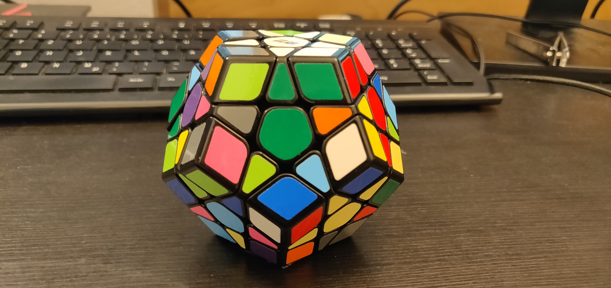
Goals
Goal 4

Slide 12
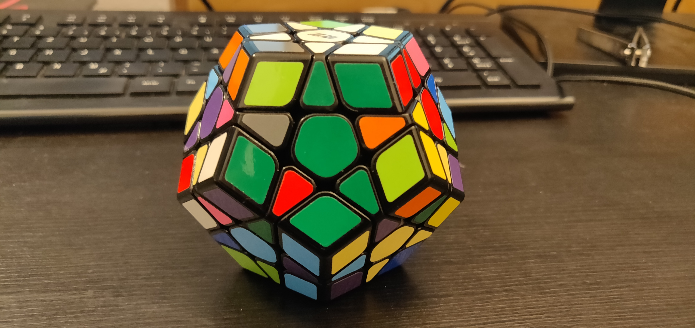
Goals
Goal 5

Slide 13
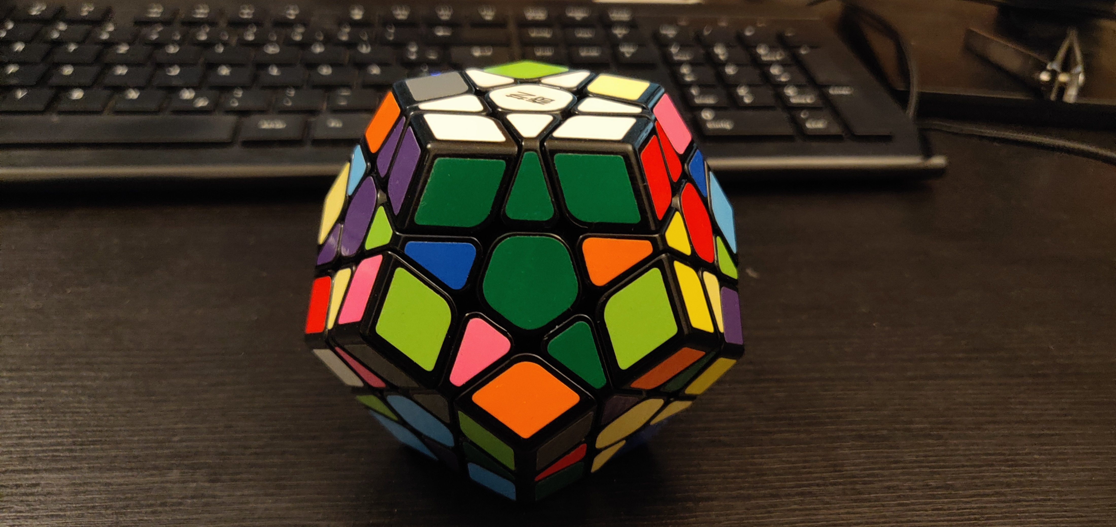
Goals
Goal 6

Slide 14
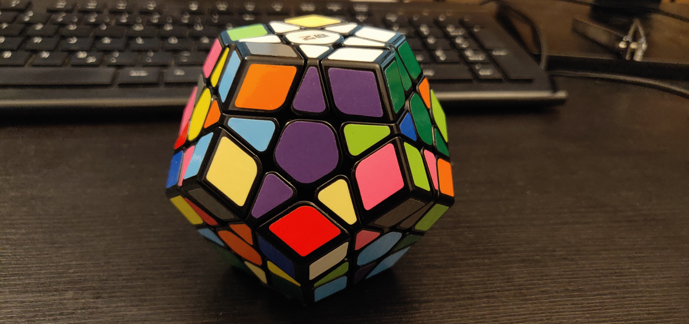
Goals
Goal 7

Slide 15
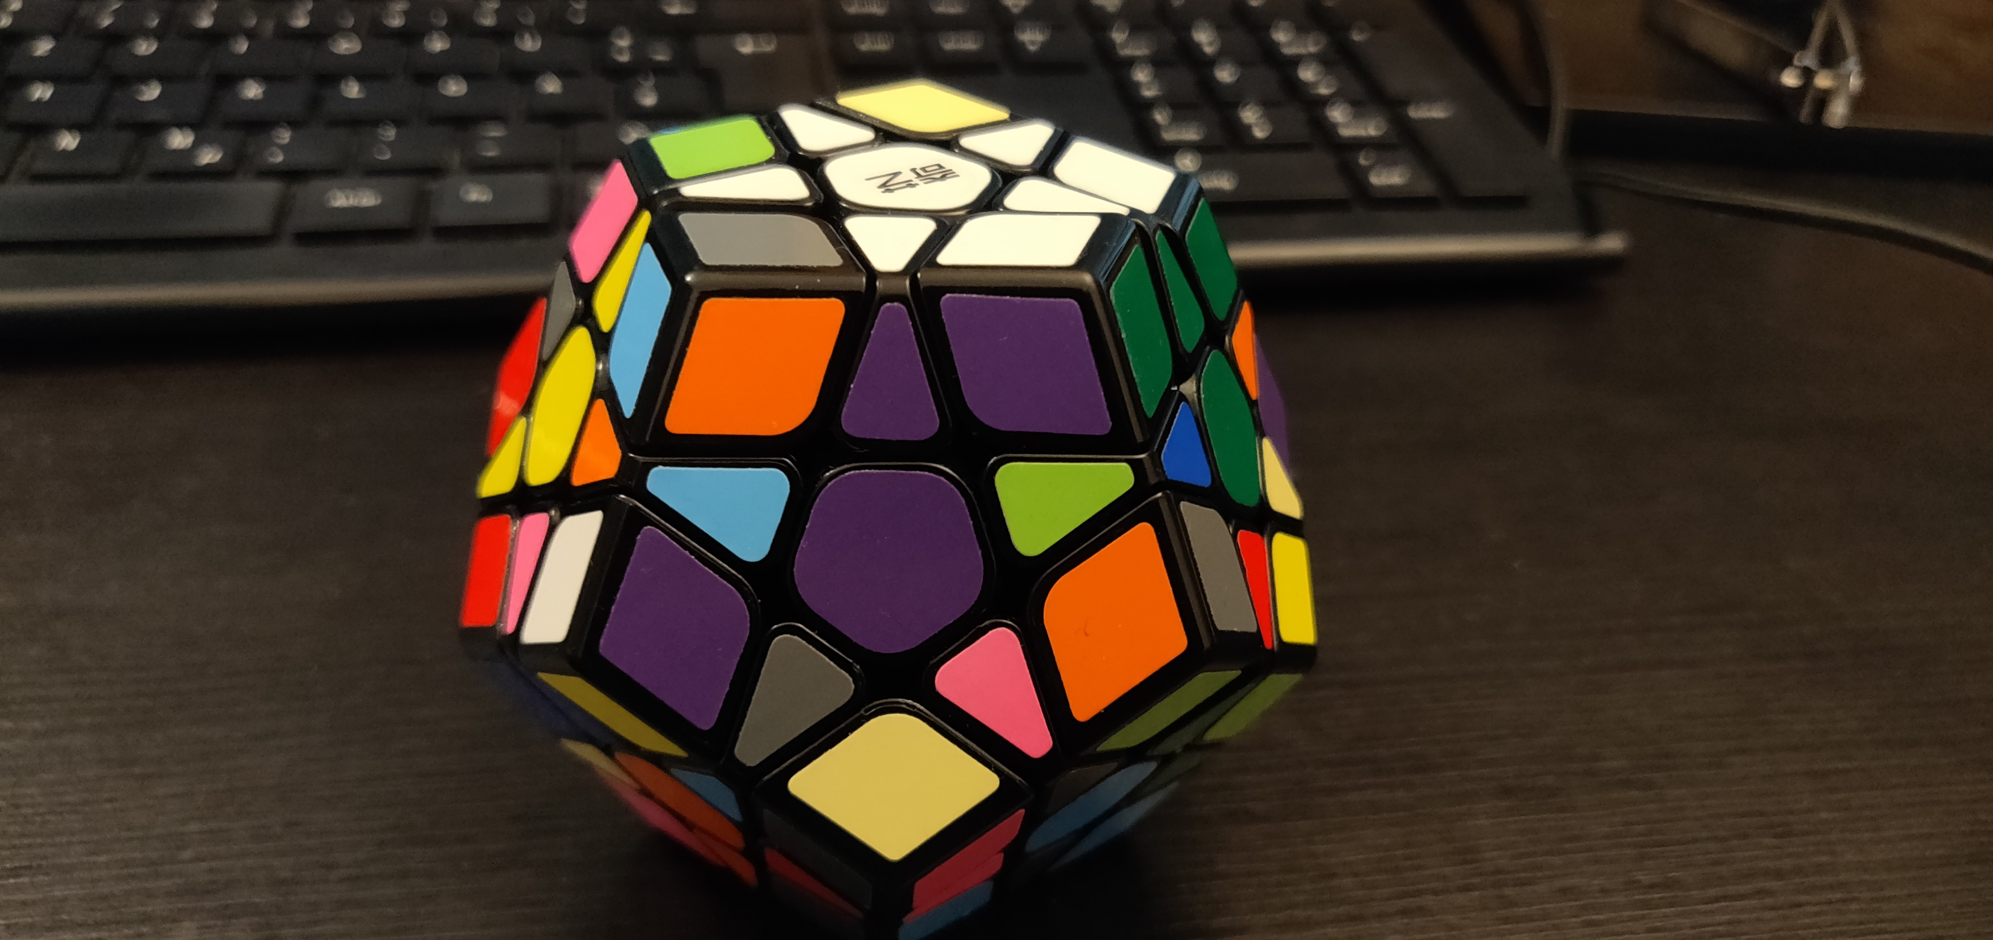
Goals
Goal 8

Slide 16
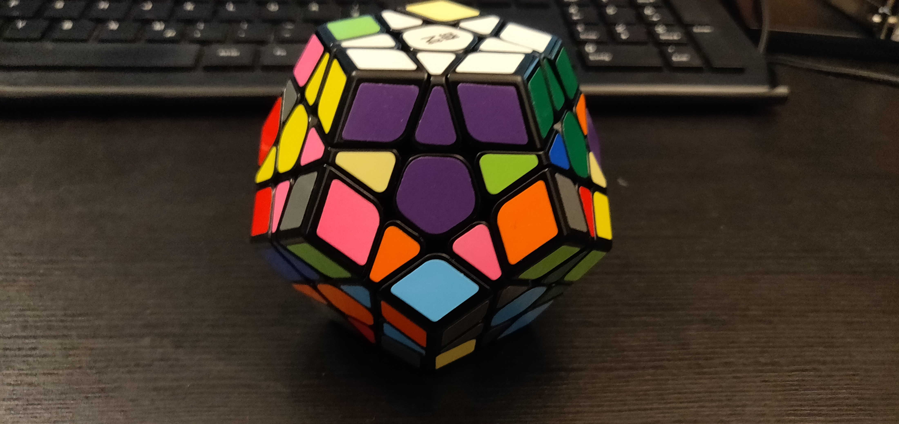
Goals
Goal 9

Slide 17
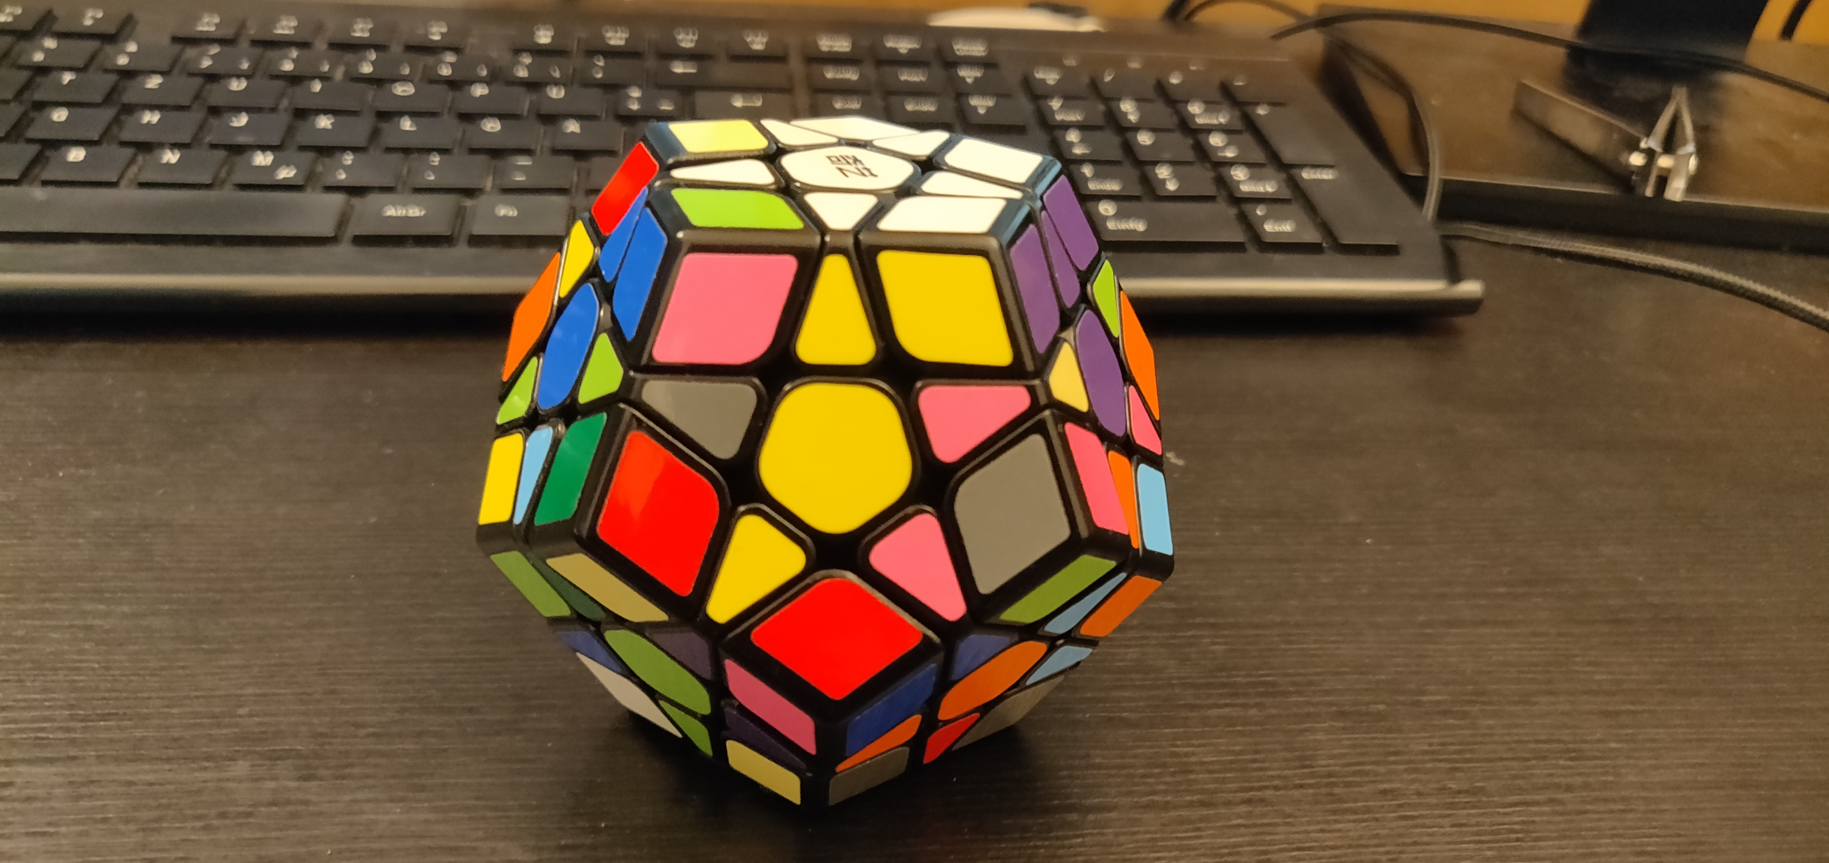
Goals
Goal 10

Slide 18
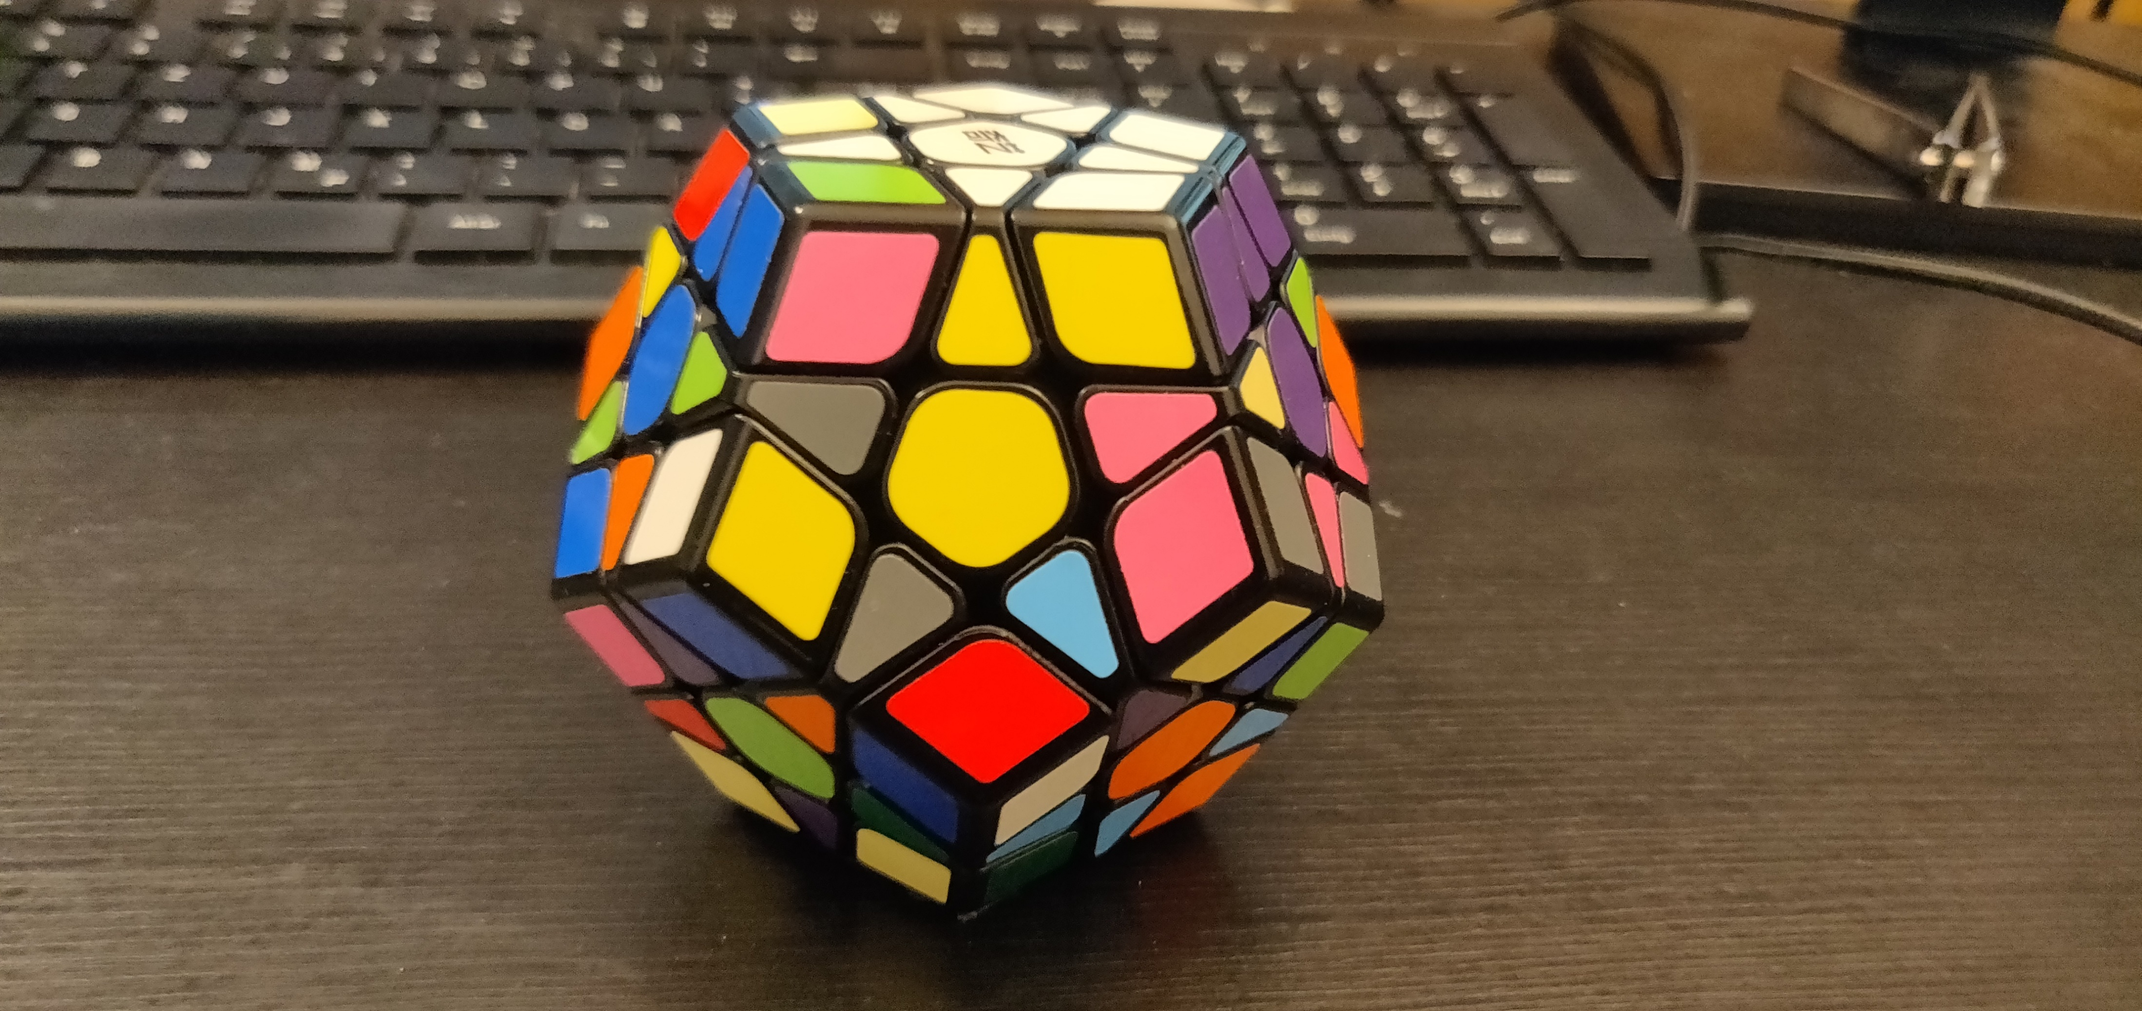
Goals
Goal 11

Slide 19
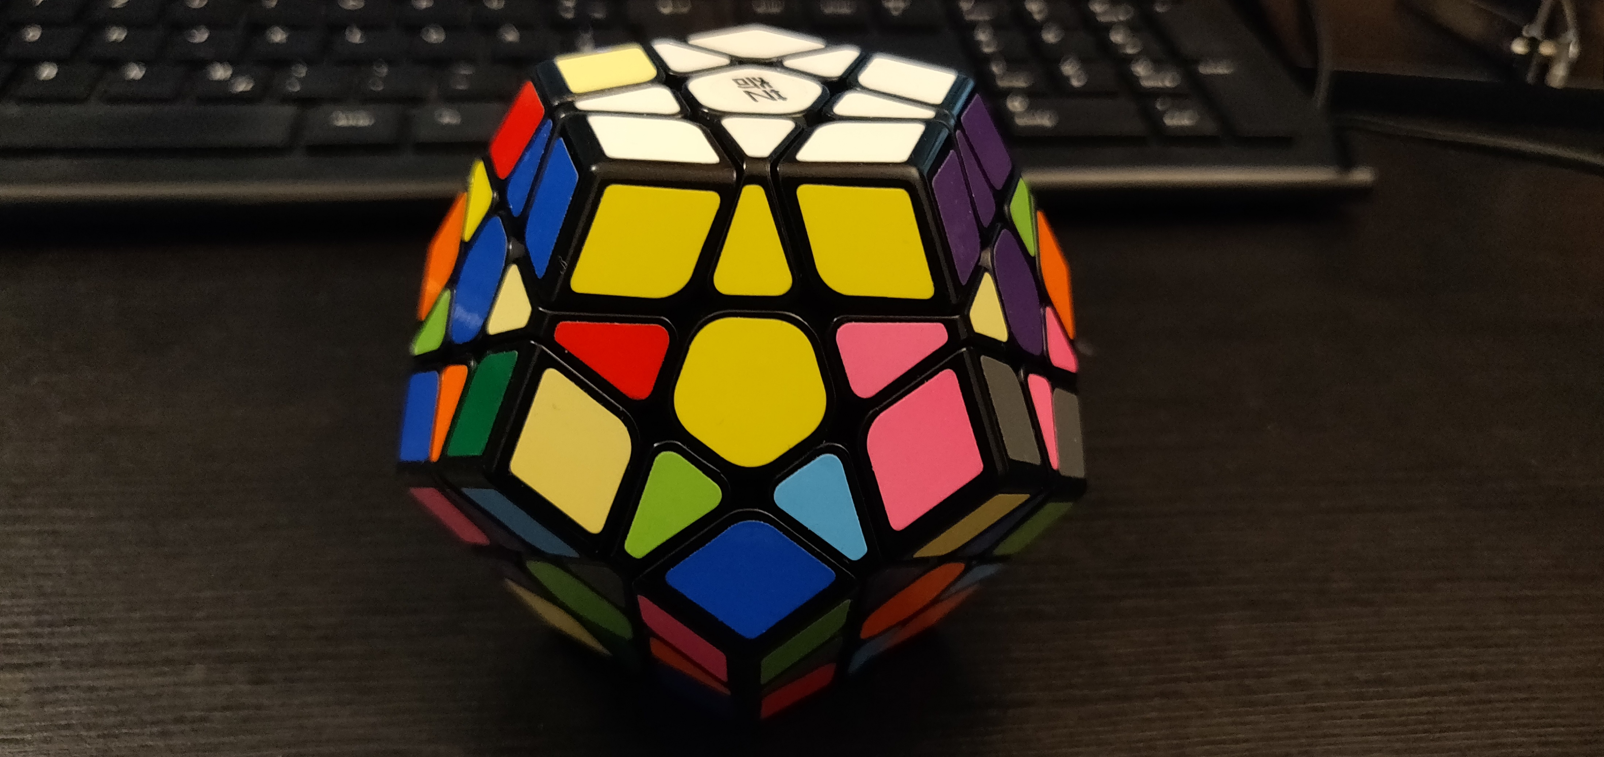
Goals
Goal 12

Slide 20
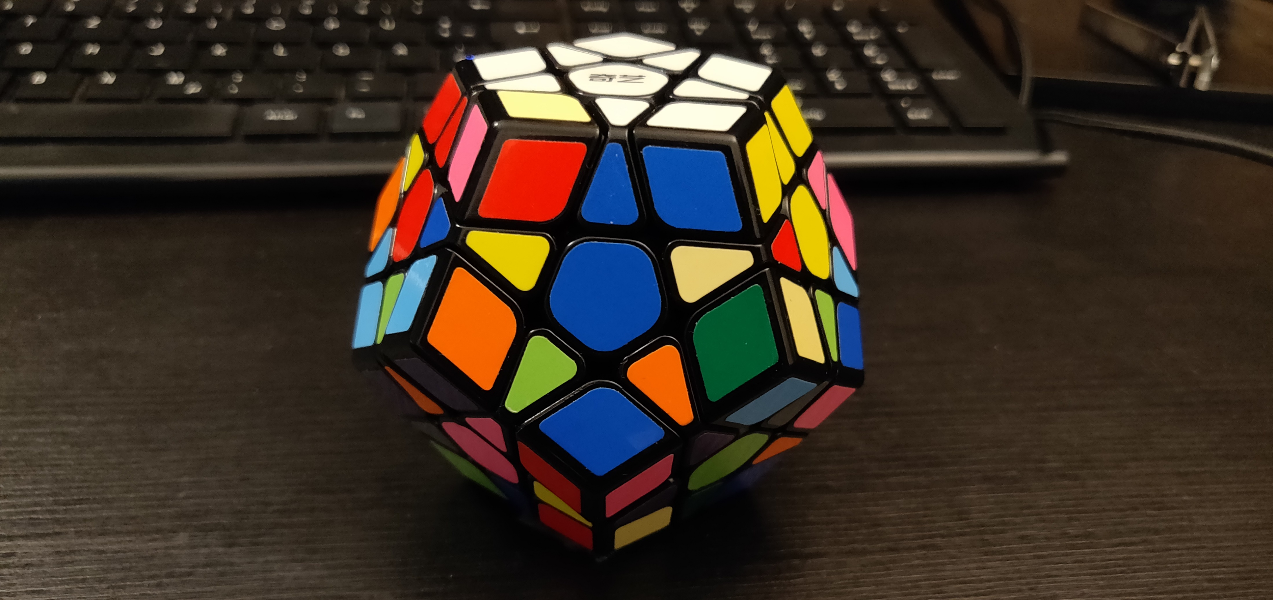
Goals
Goal 13

Slide 21
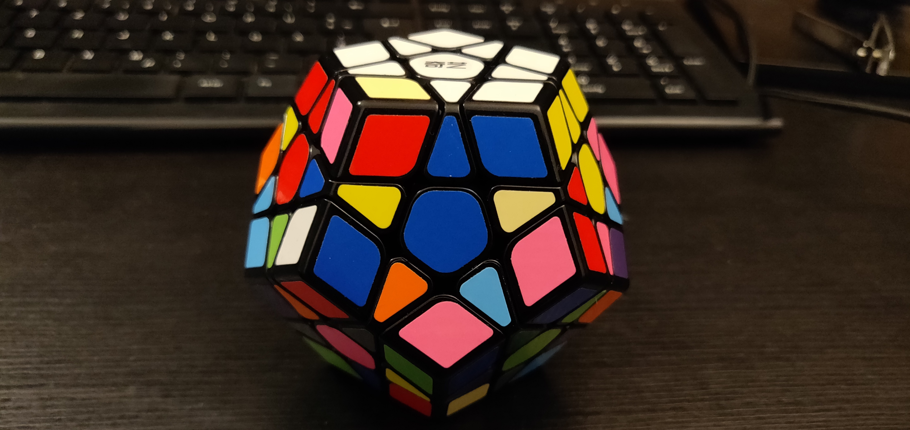
Goals
Goal 14

Slide 22
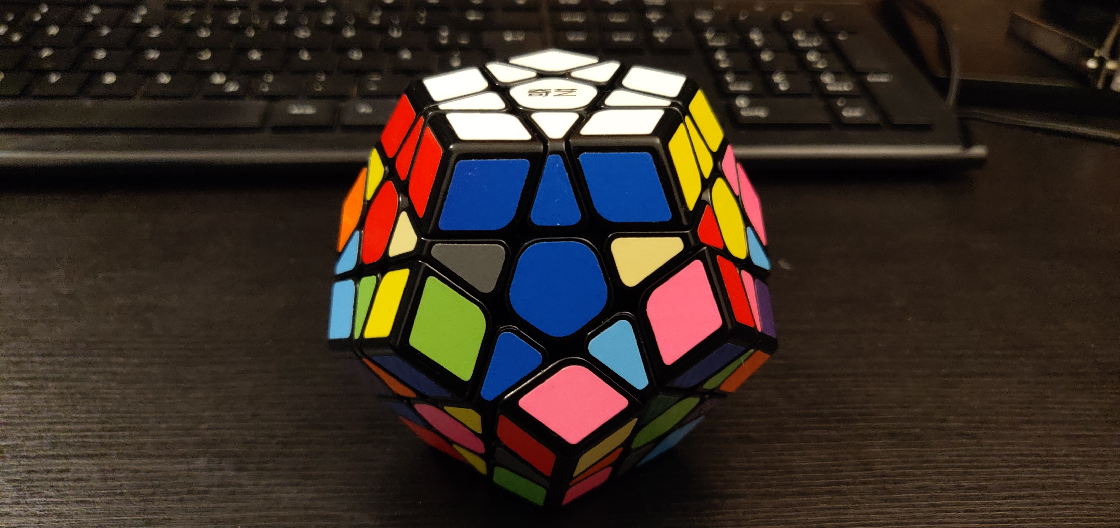
Goals
Goal 15

Slide 23
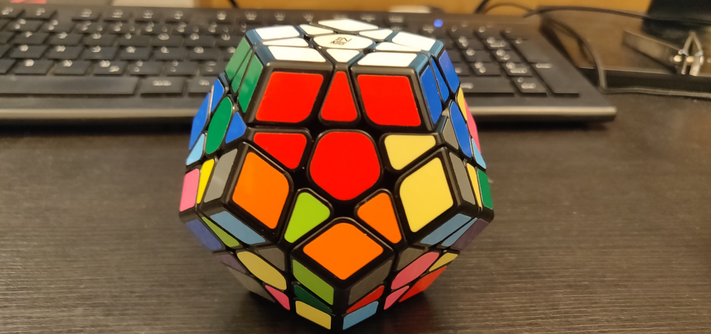
Goals
Goal 16

Slide 24
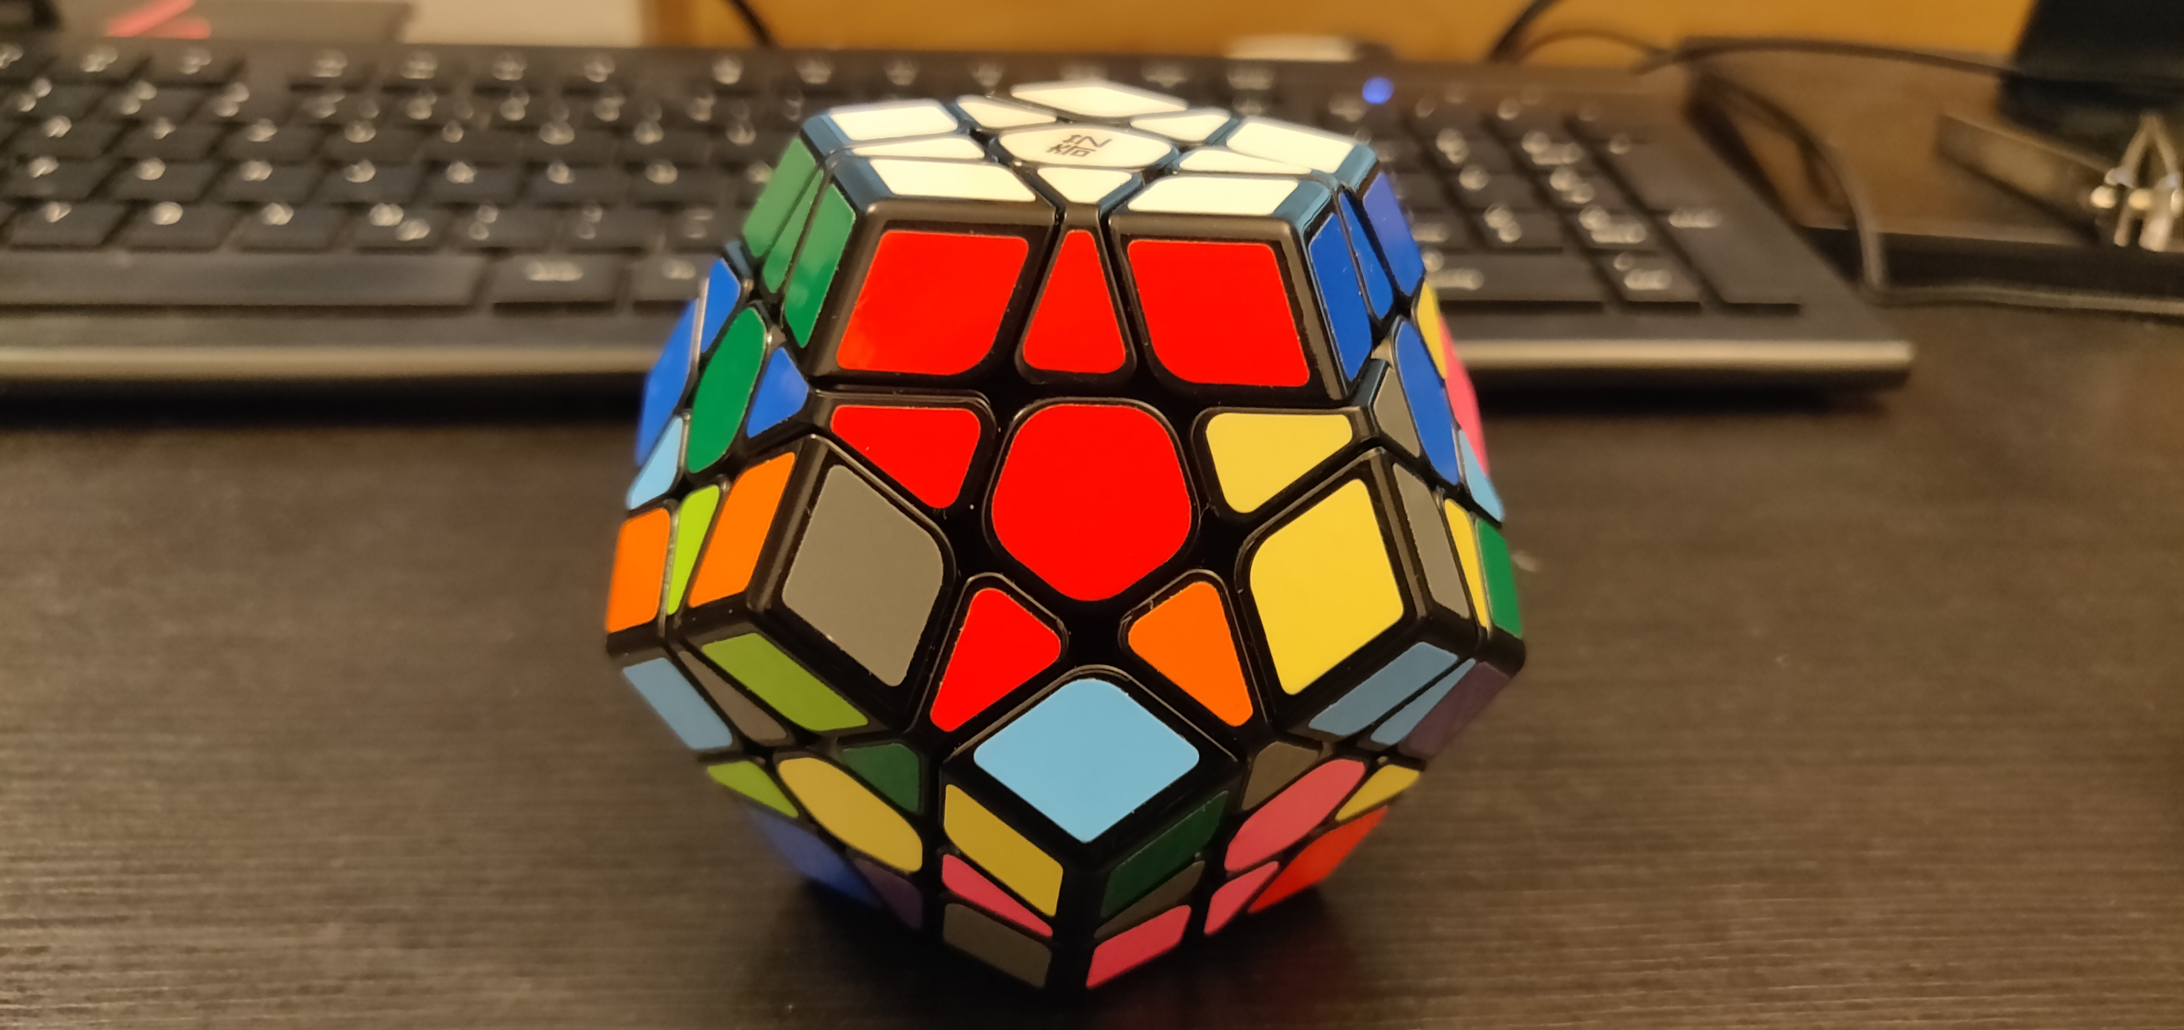
Goals
Goal 17

Slide 25
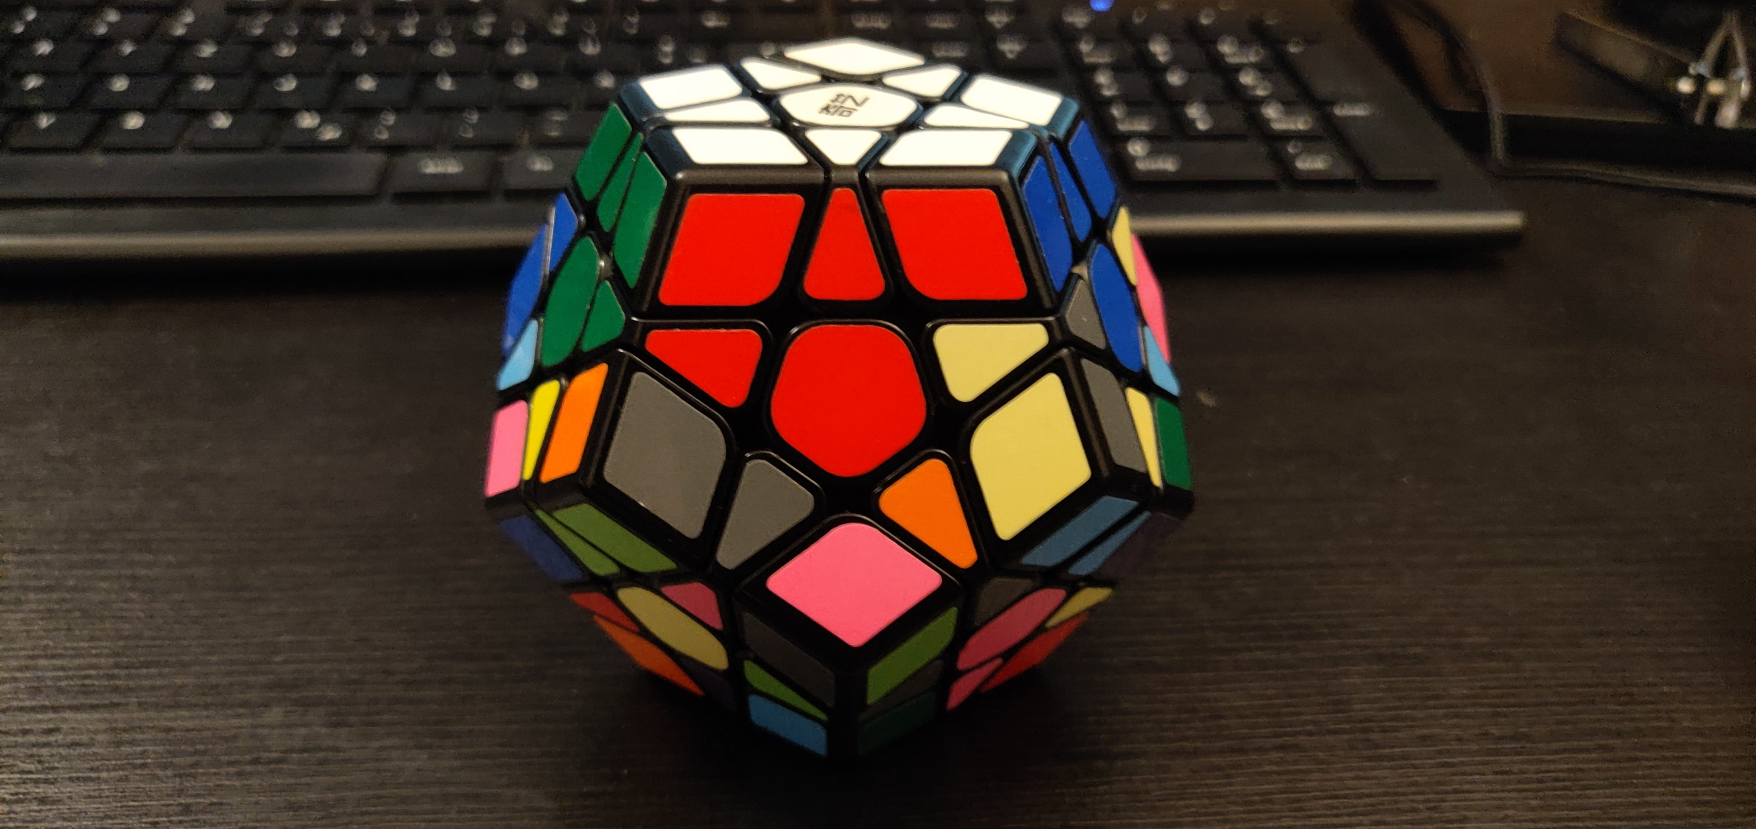
Goals
Goal 18

Slide 26
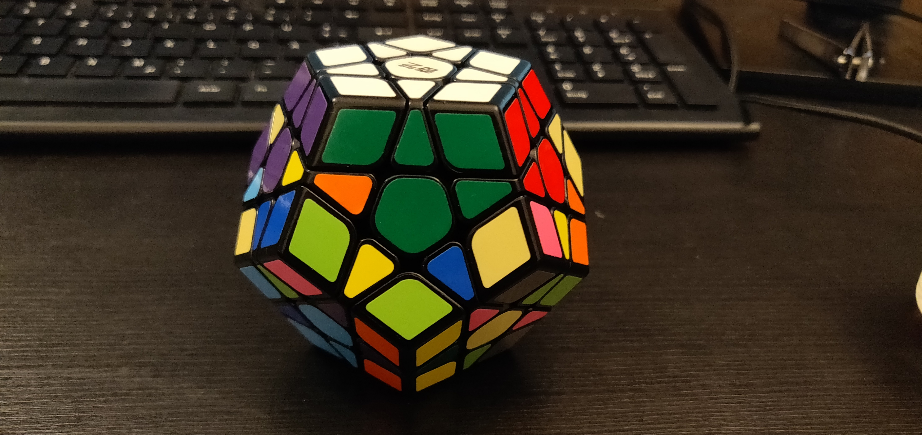
Goals
Goal 19

Slide 27
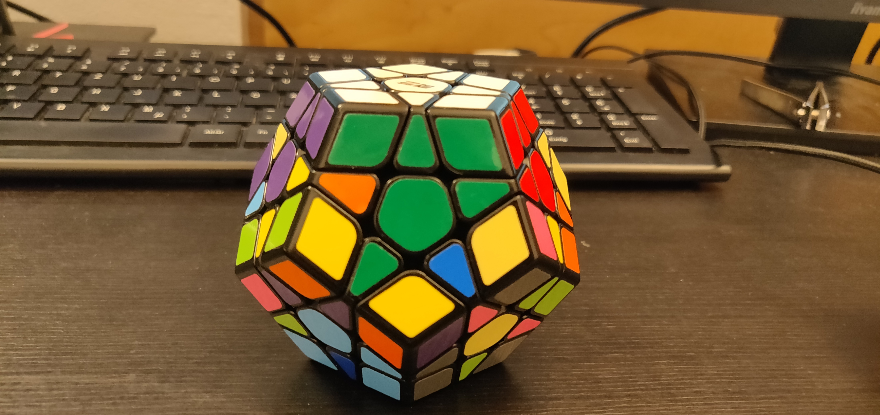
Goals
Goal 20

Slide 28
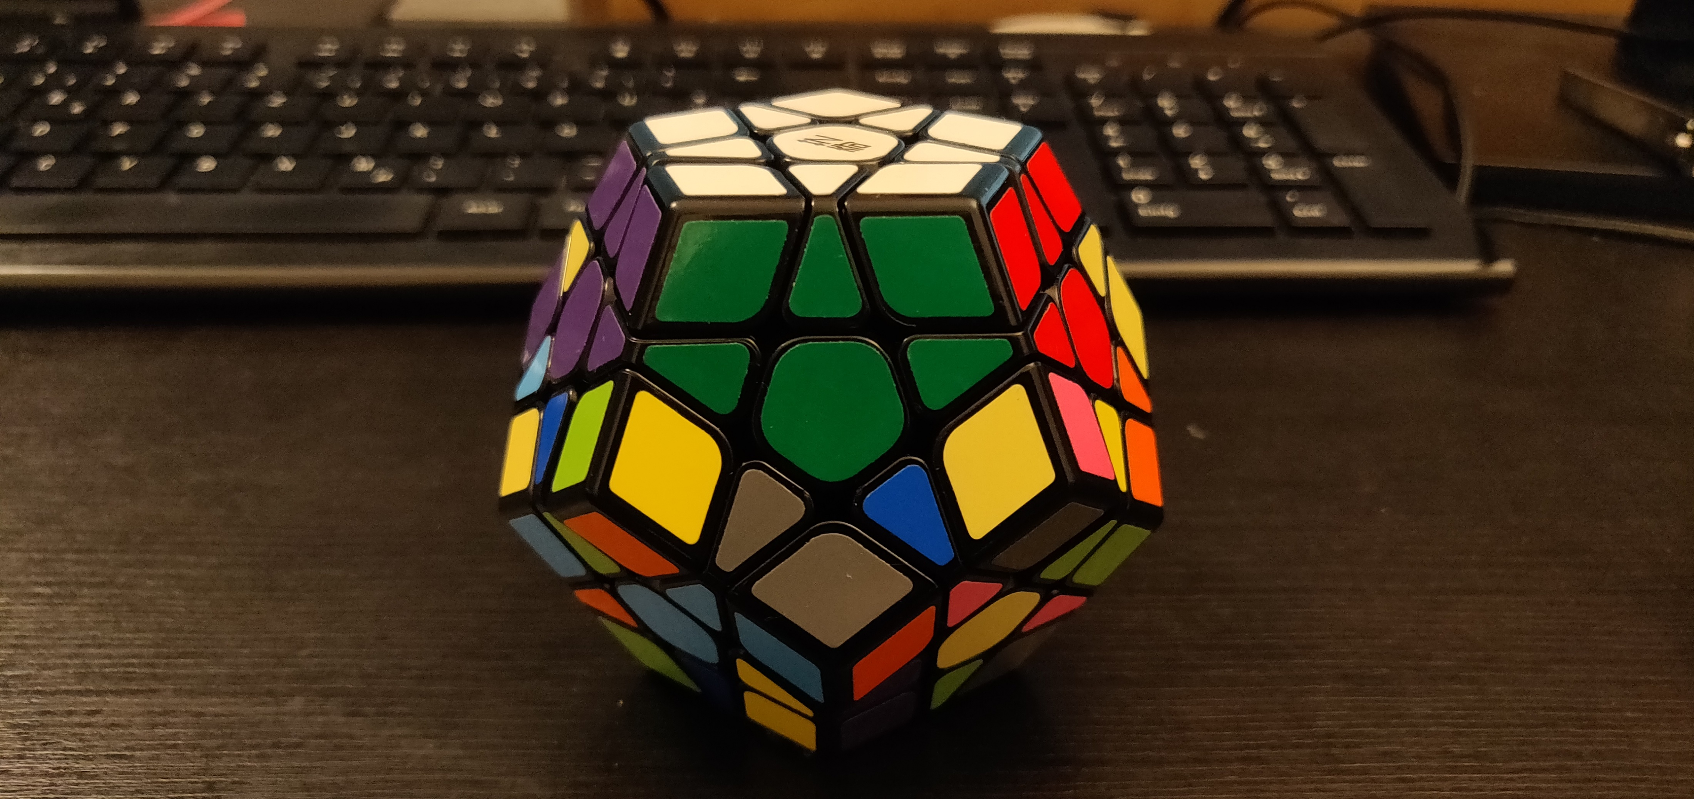
Goals
Goal 21

Slide 29
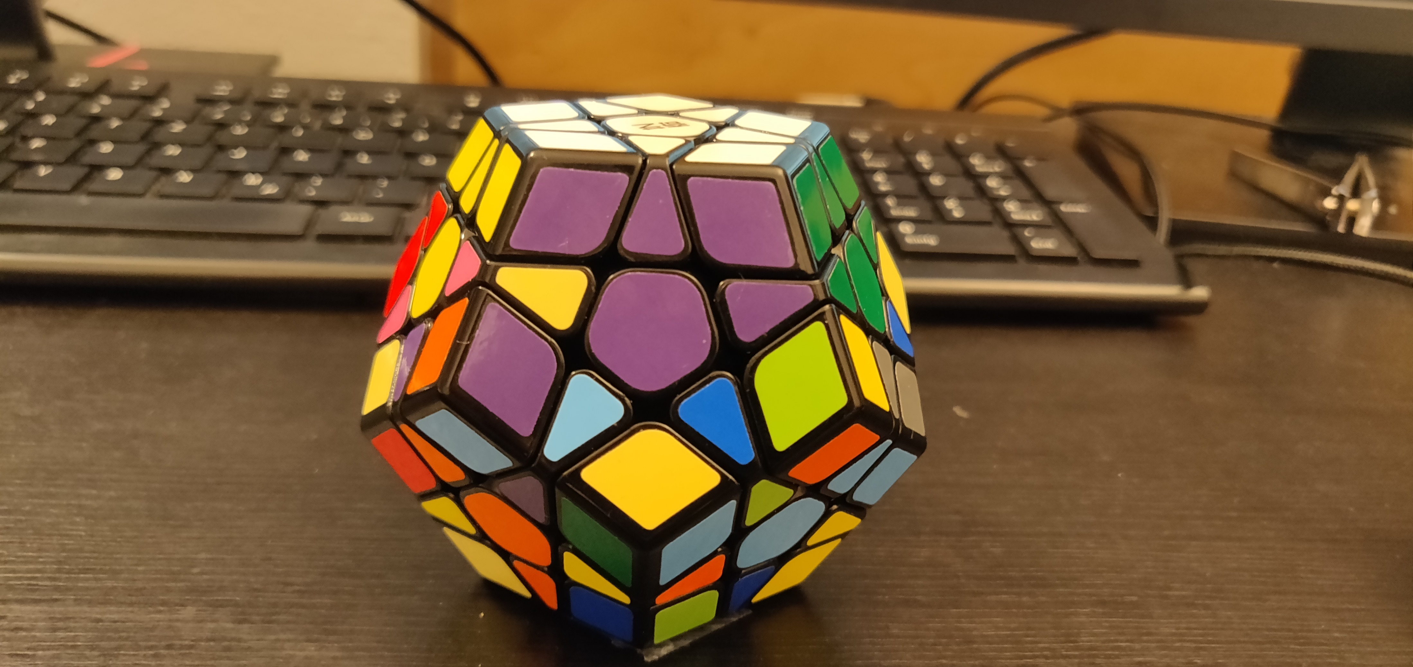
Goals
Goal 22

Slide 30
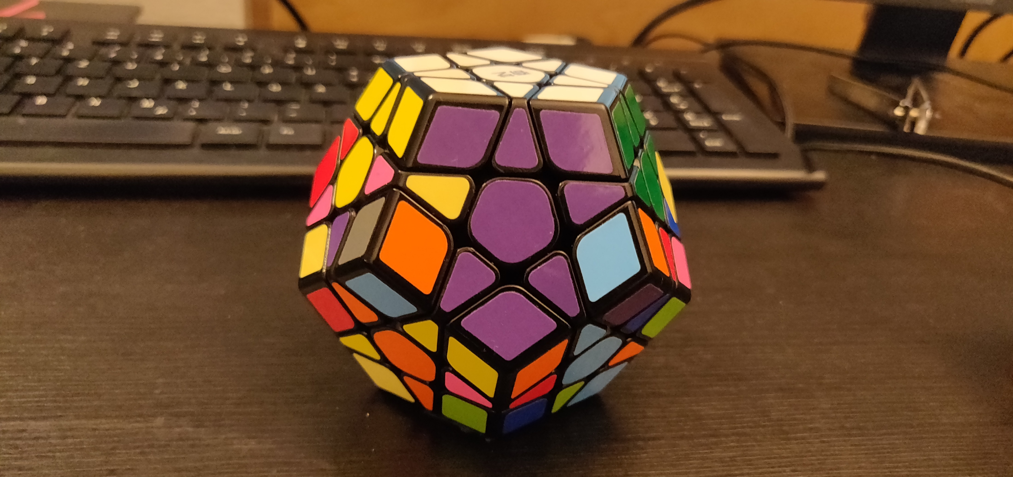
Goals
Goal 23

Slide 31
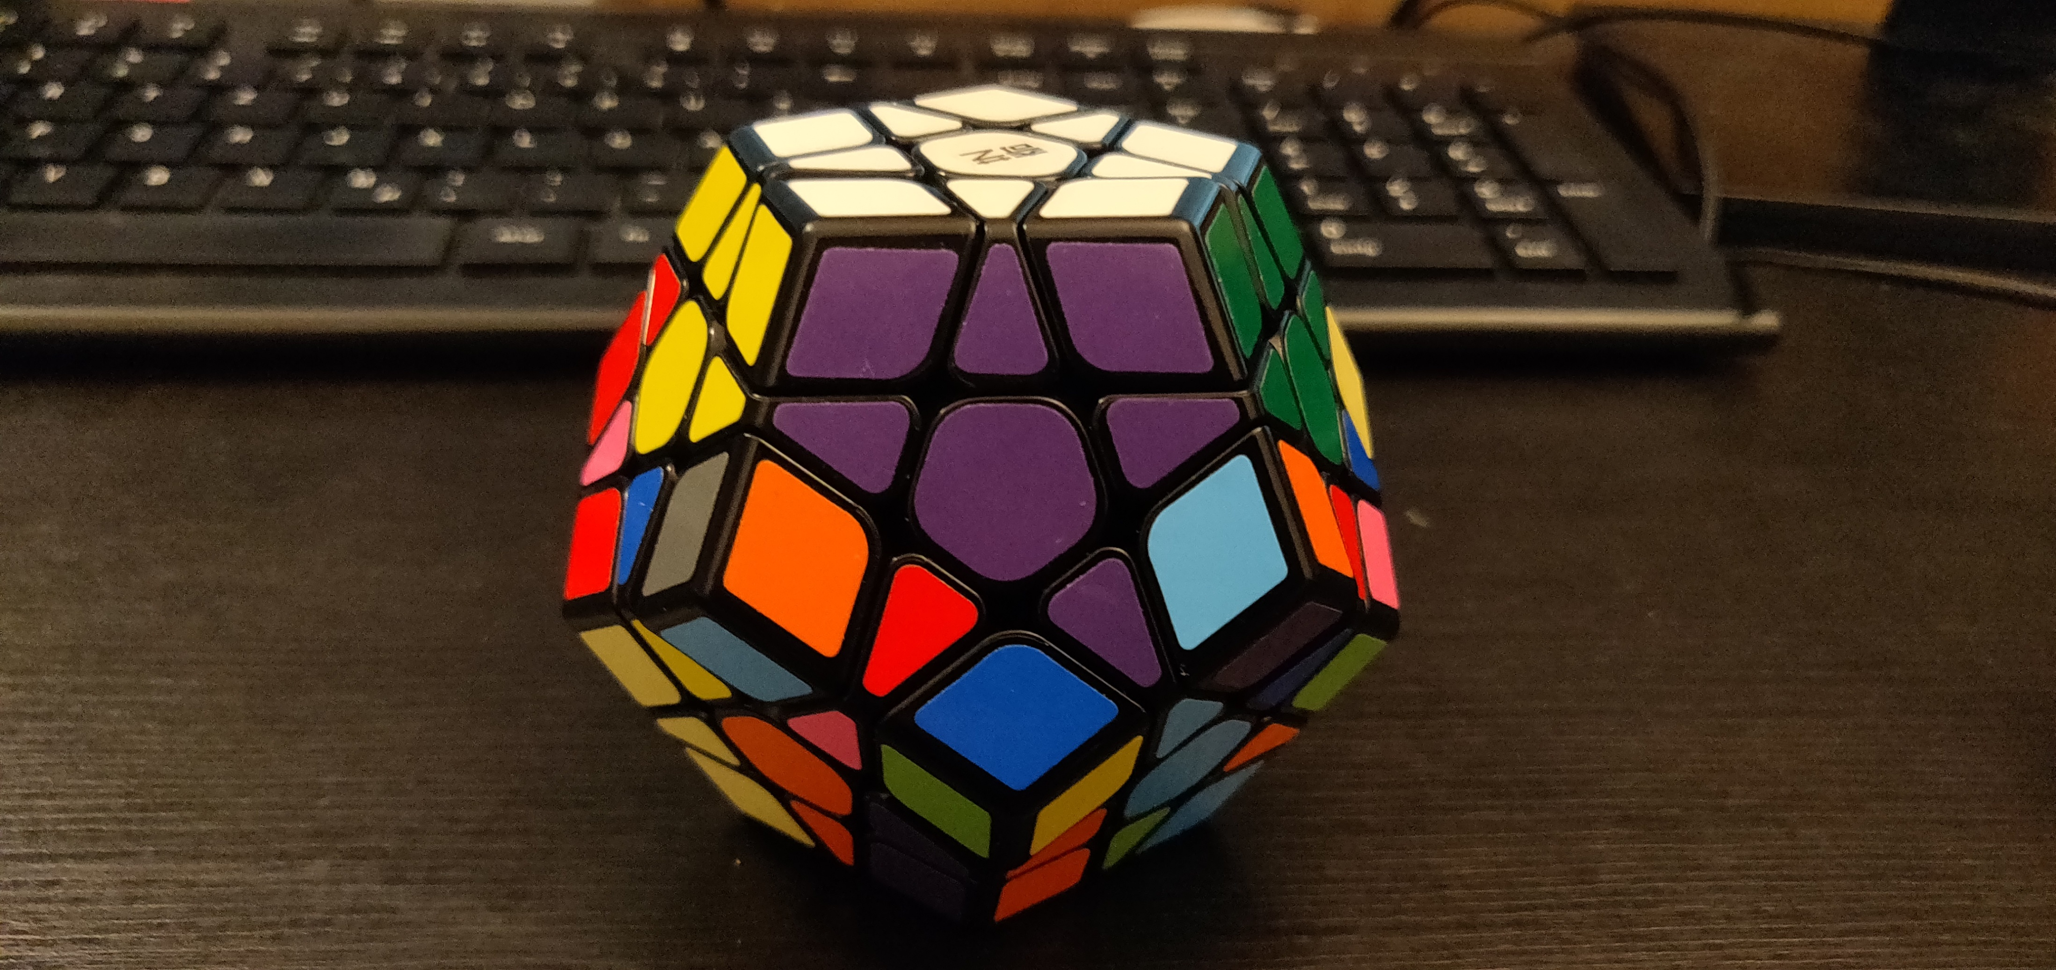
Goals
Goal 24

Slide 32
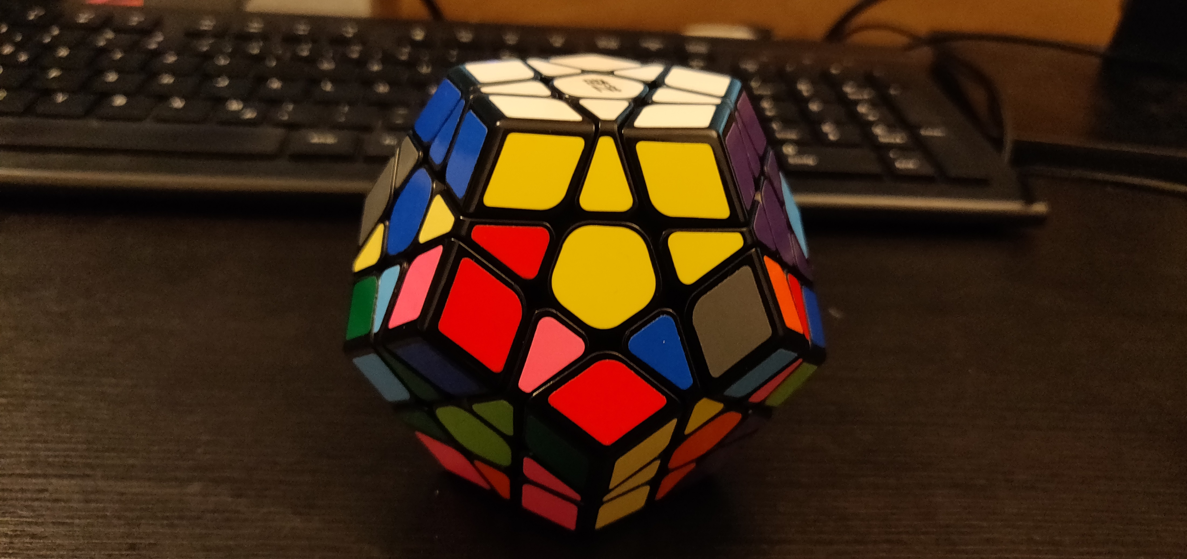
Goals
Goal 25

Slide 33
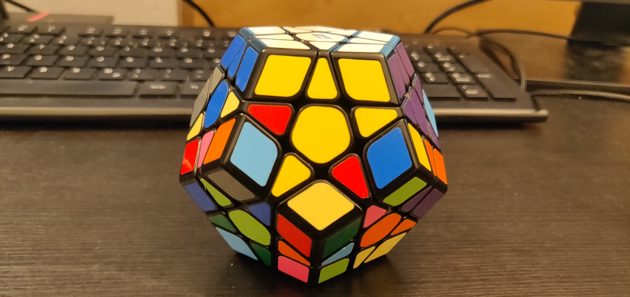
Goals
Goal 26

Slide 34
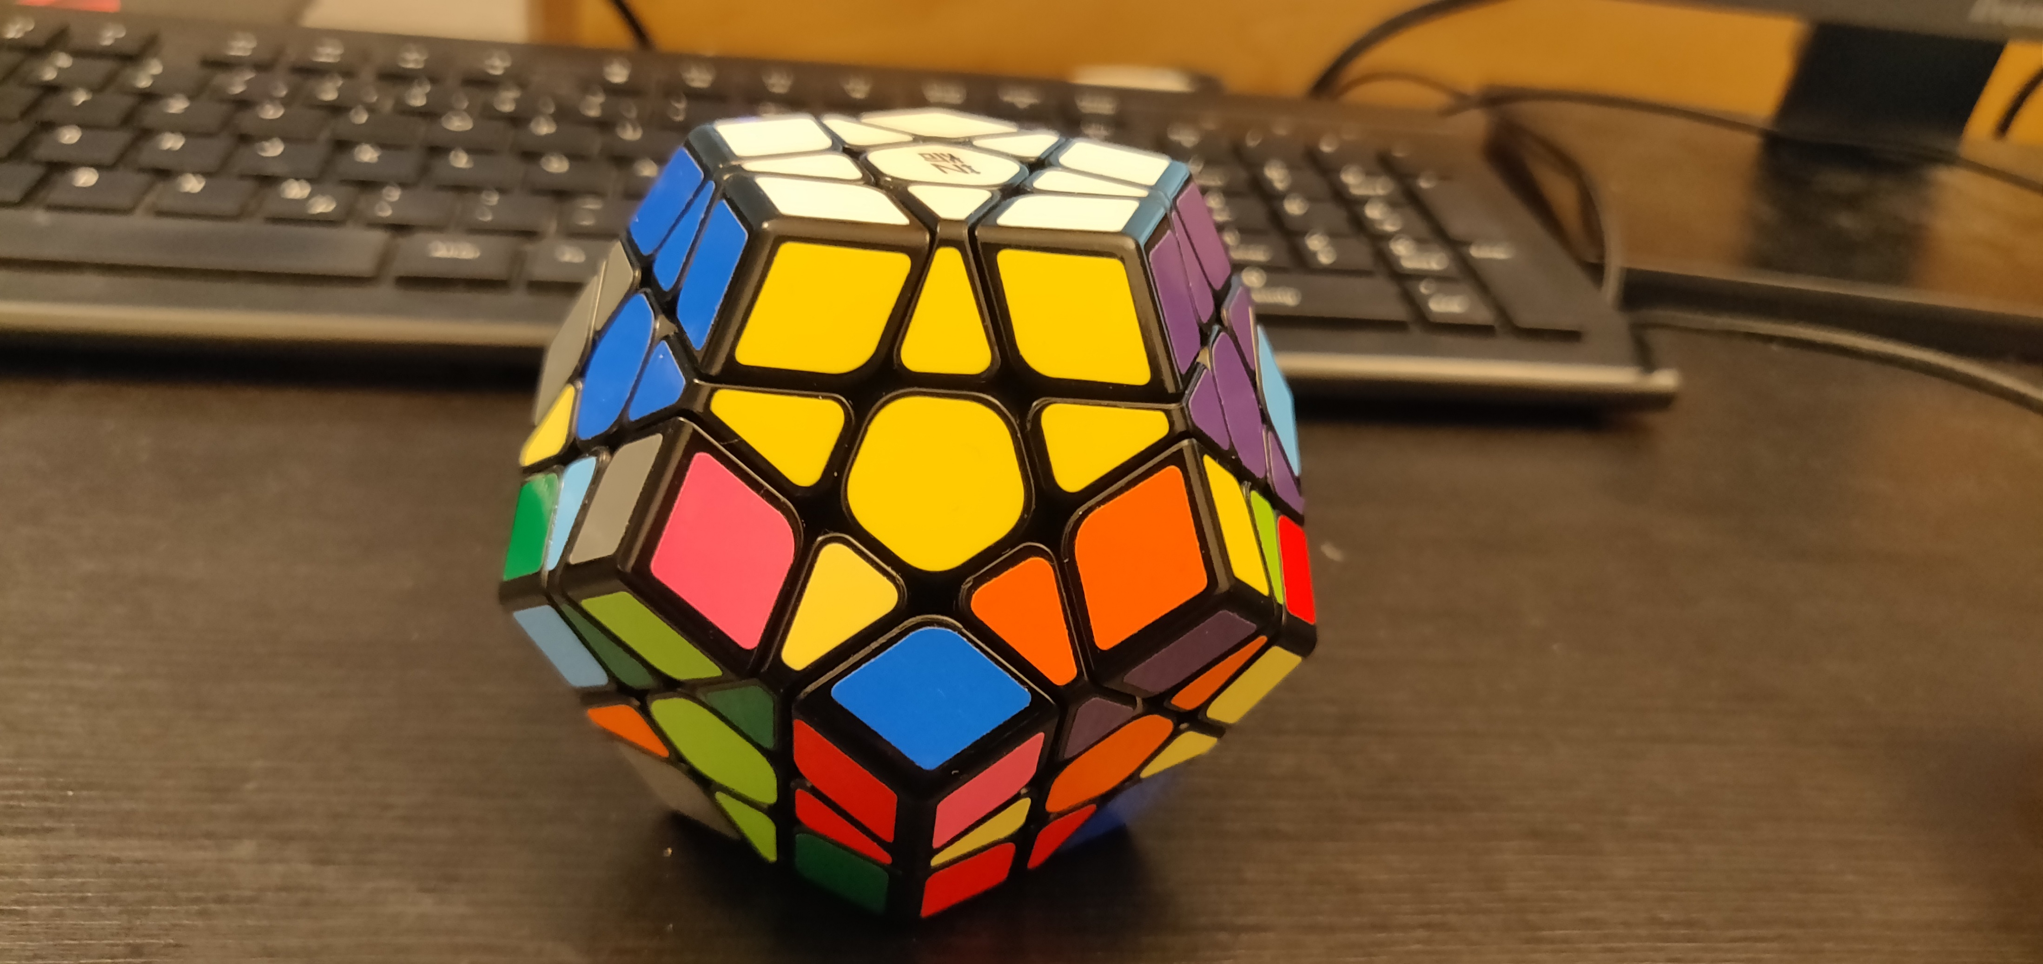
Goals
Goal 27

Slide 35
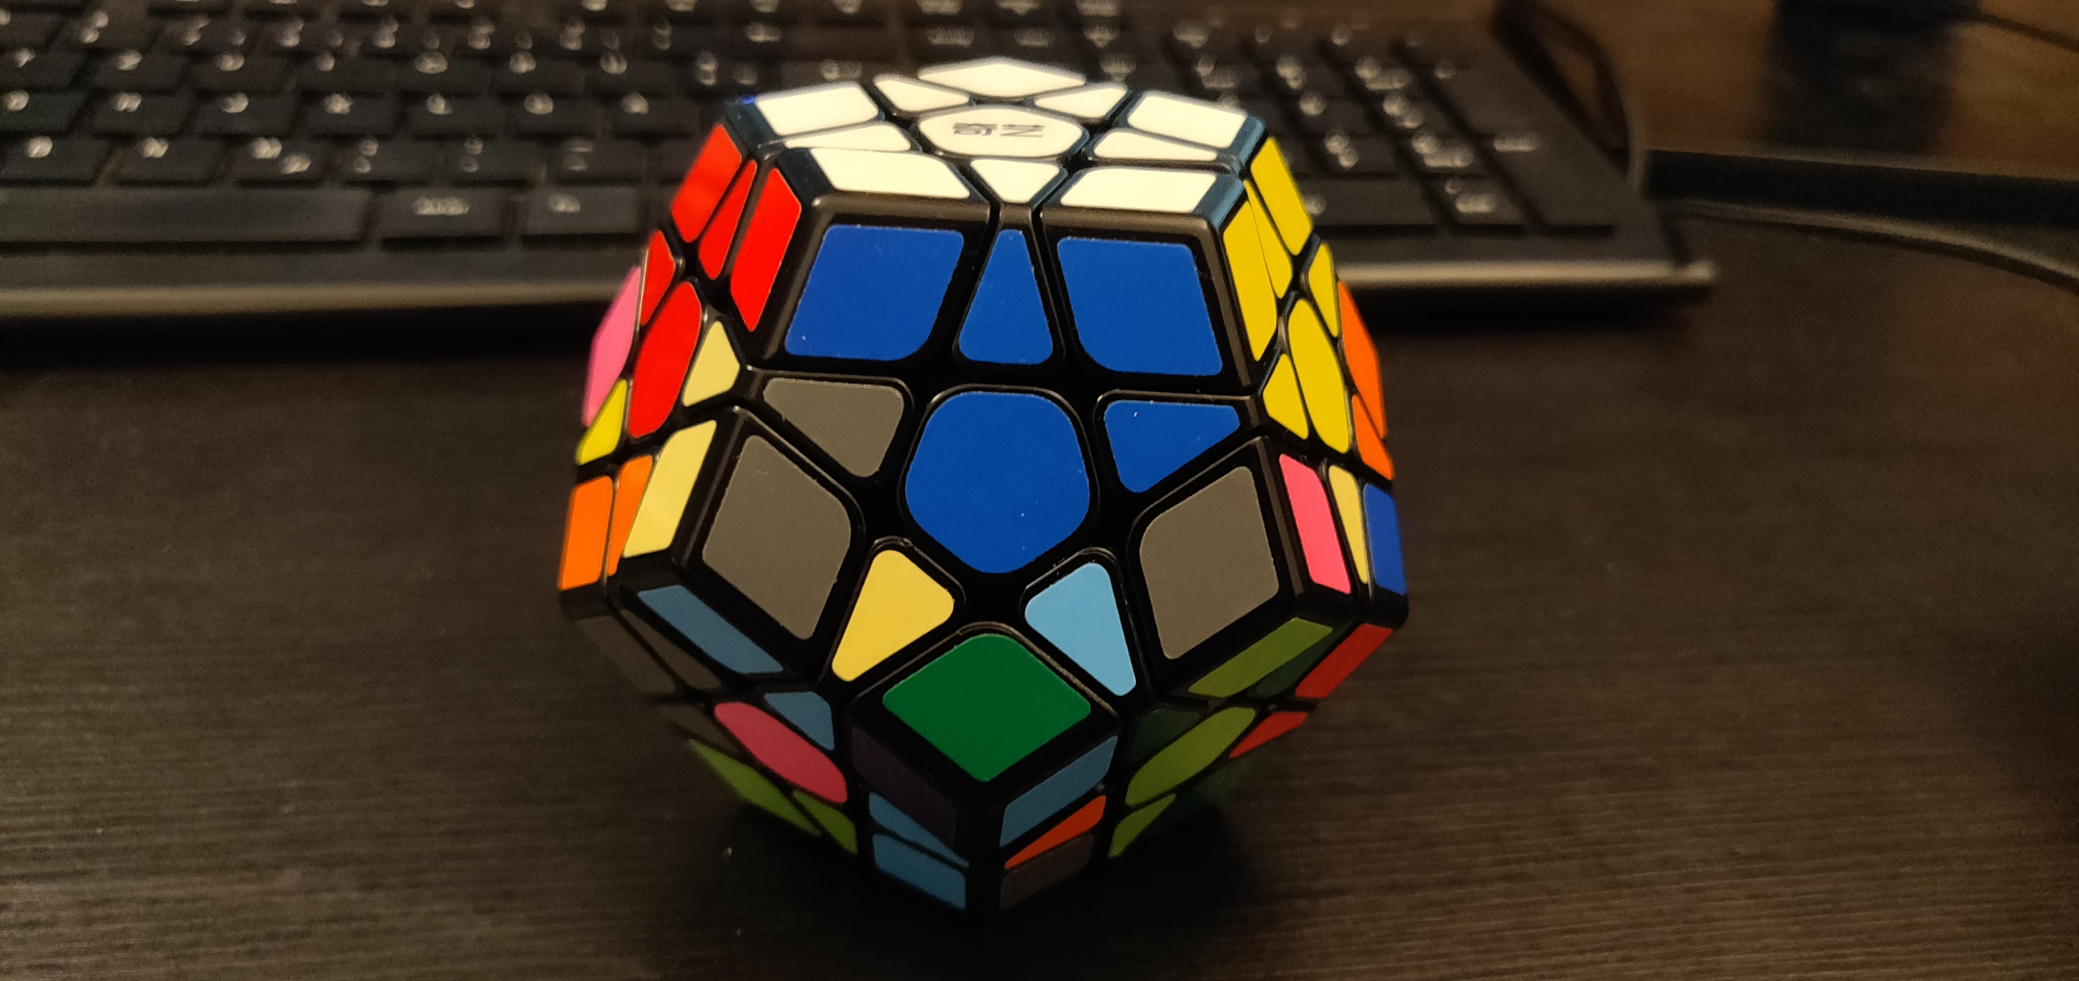
Goals
Goal 28

Slide 36
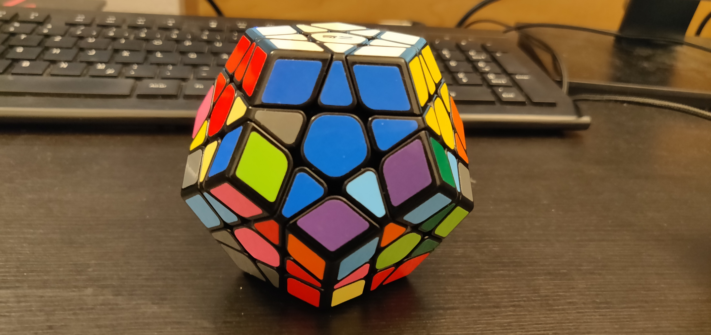
Goals
Goal 29

Slide 37
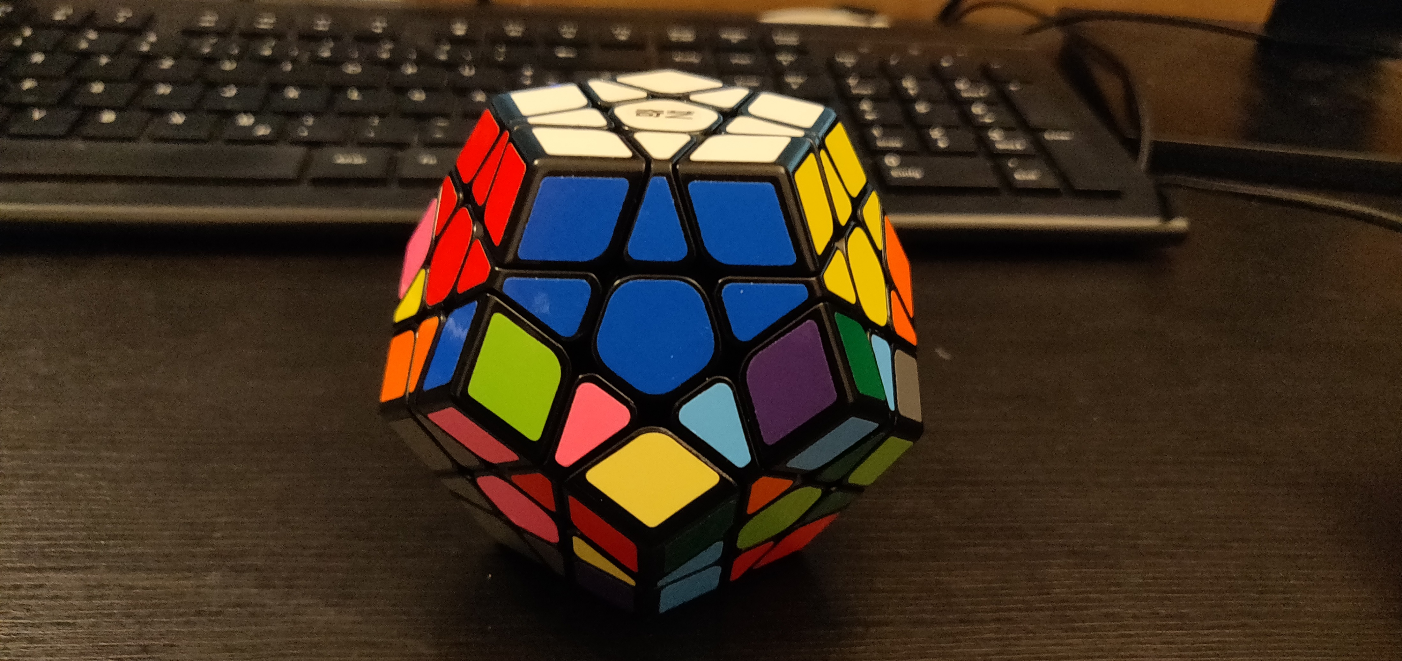
Goals
Goal 30

Slide 38
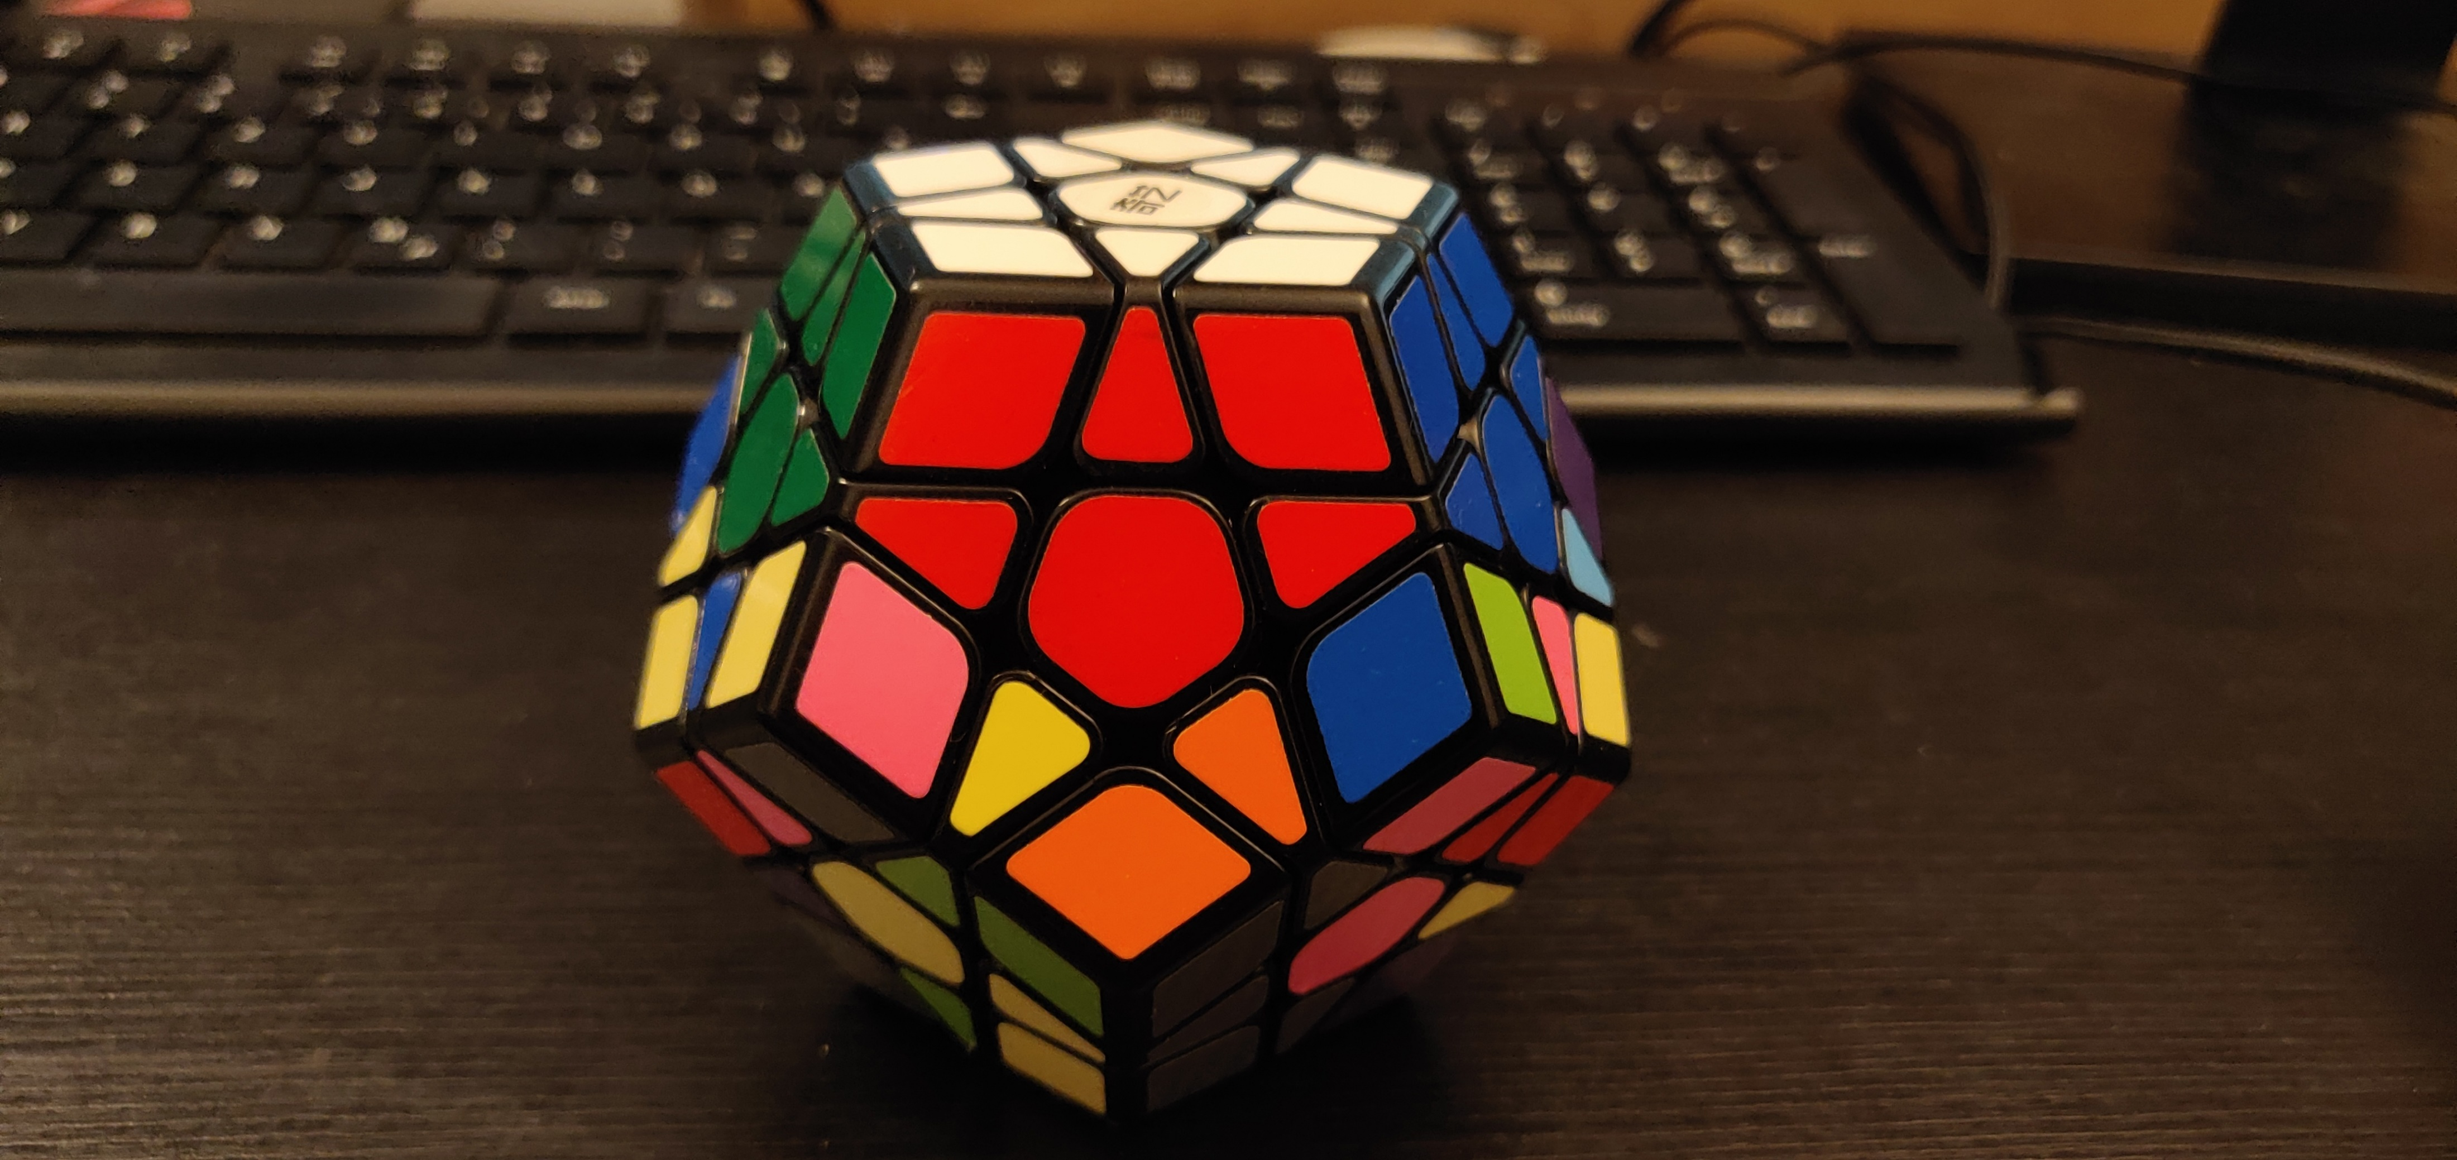
Goals
Goal 31

Slide 39
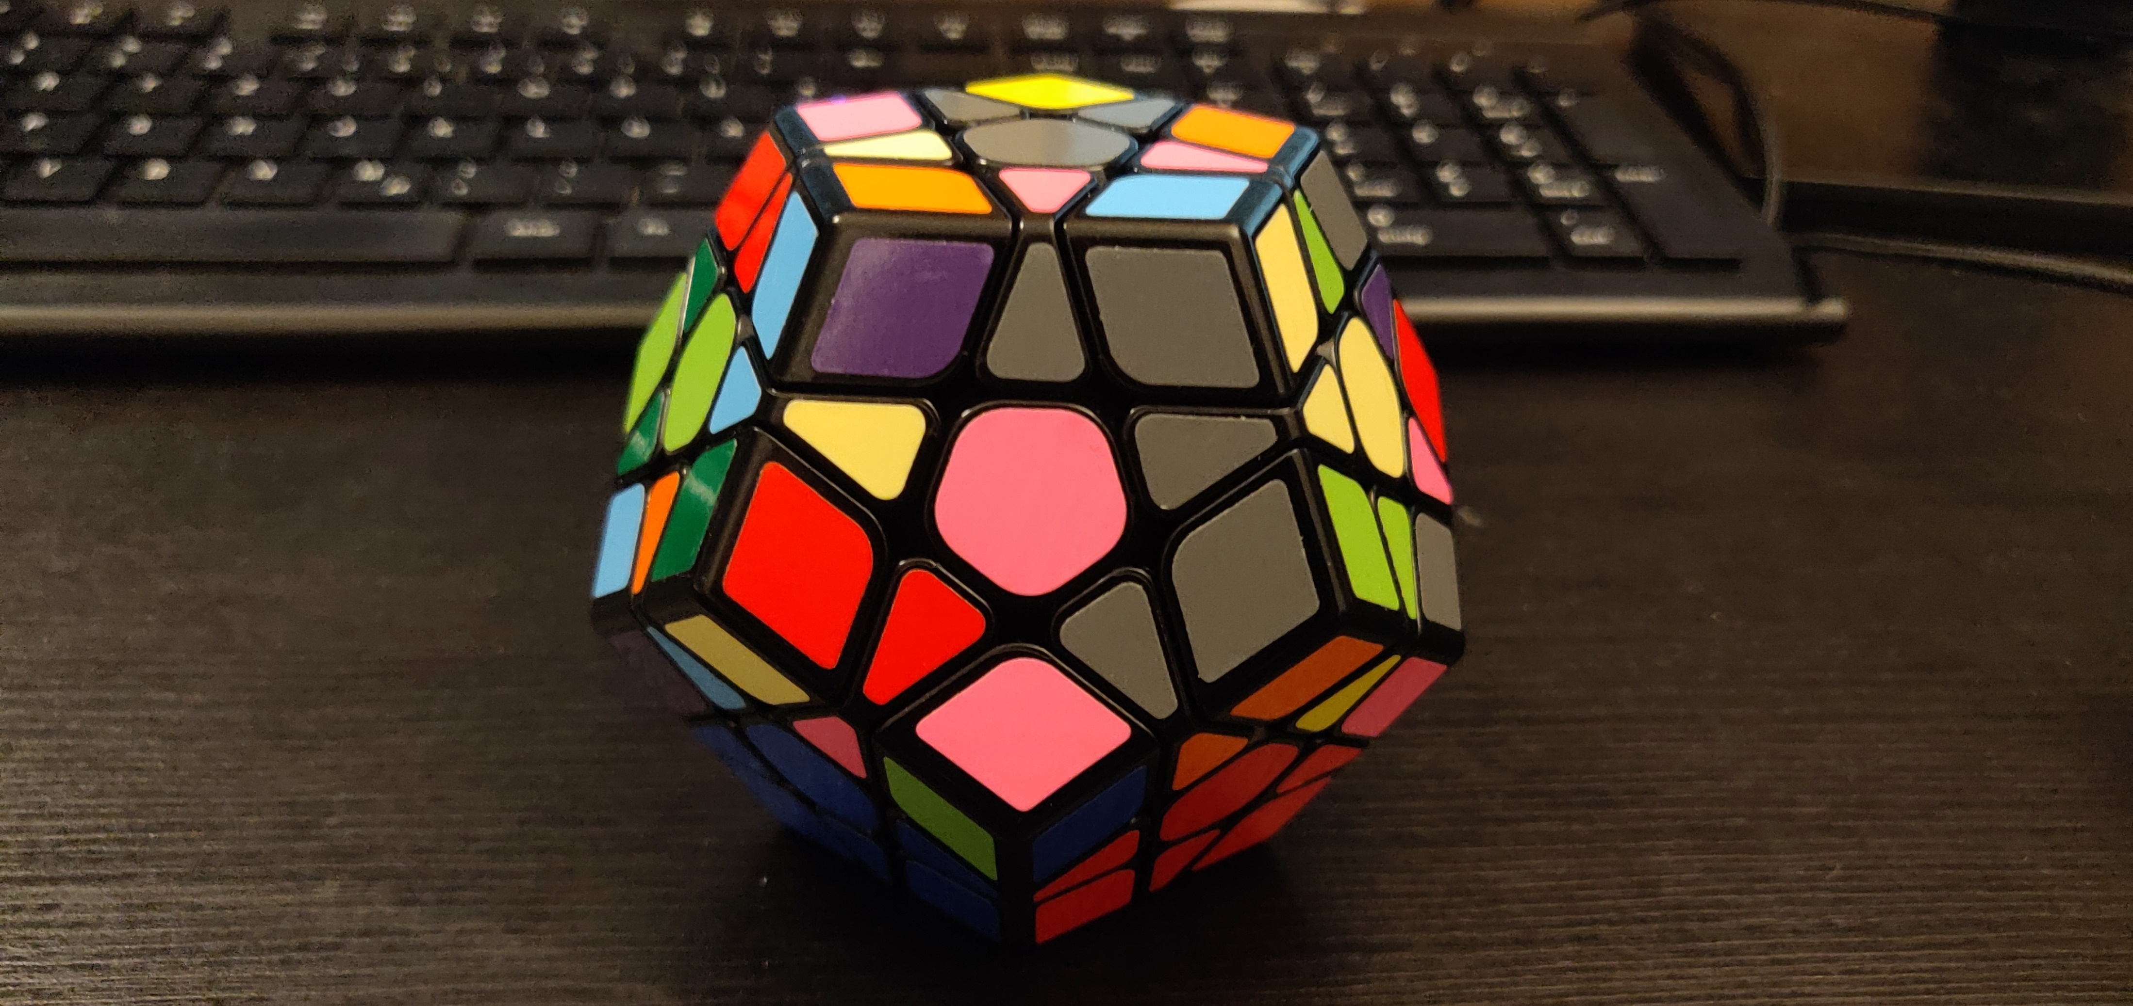
Goals
Goal 32

Slide 40
Goals
Goal 18

Slide 41
ALGORITHMS
BACKUP
dl l dl‘ l‘
l dl l‘
(l dl‘ l‘) dl dl l dl l‘

Slide 42
ALGORITHMS
BACKUP
(l‘ f‘ l dl) (l dl‘ l‘ f)
(l dl l‘ dl‘ l‘) (f‘ dl f)

Slide 43
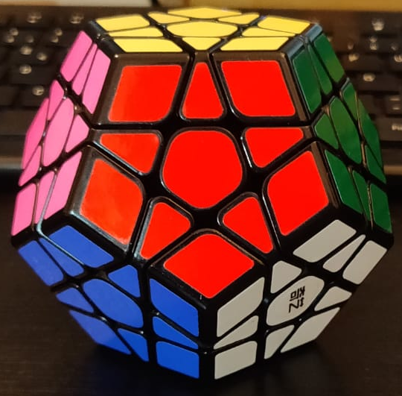
Beginning Position
U
L
R
Allowed Moves:
Up
Right
Front
Left
BACKUP
F

Slide 44
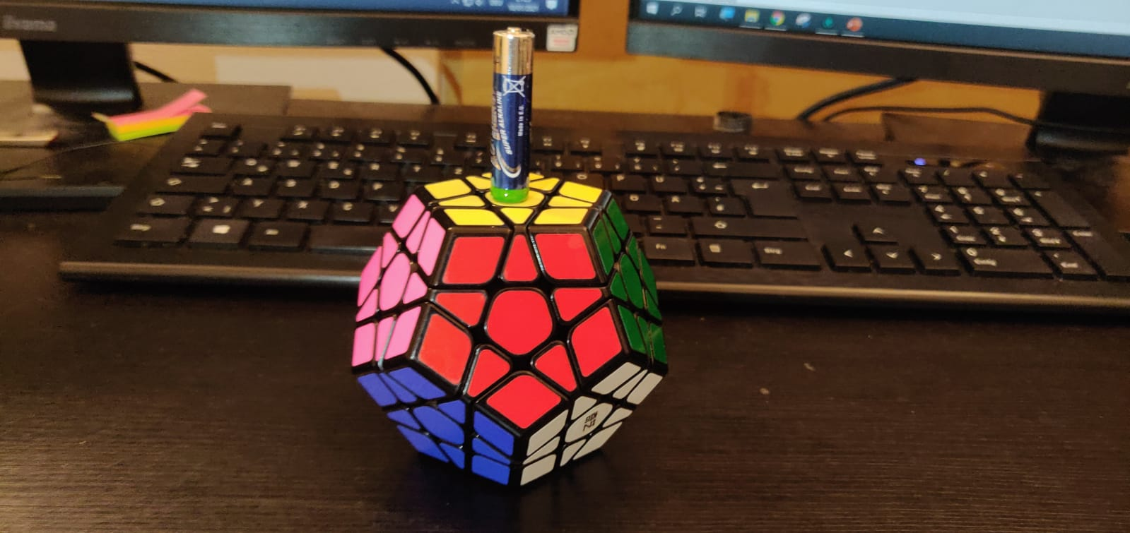
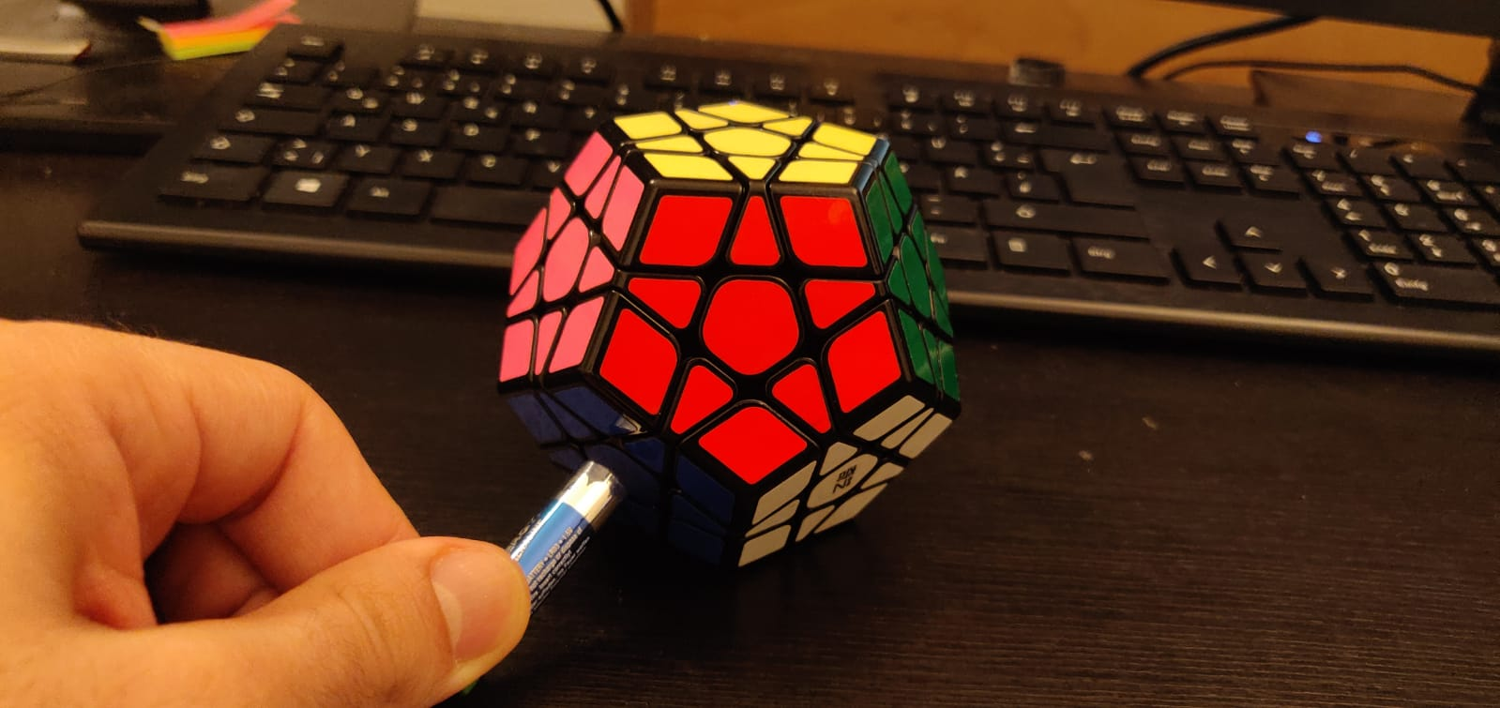
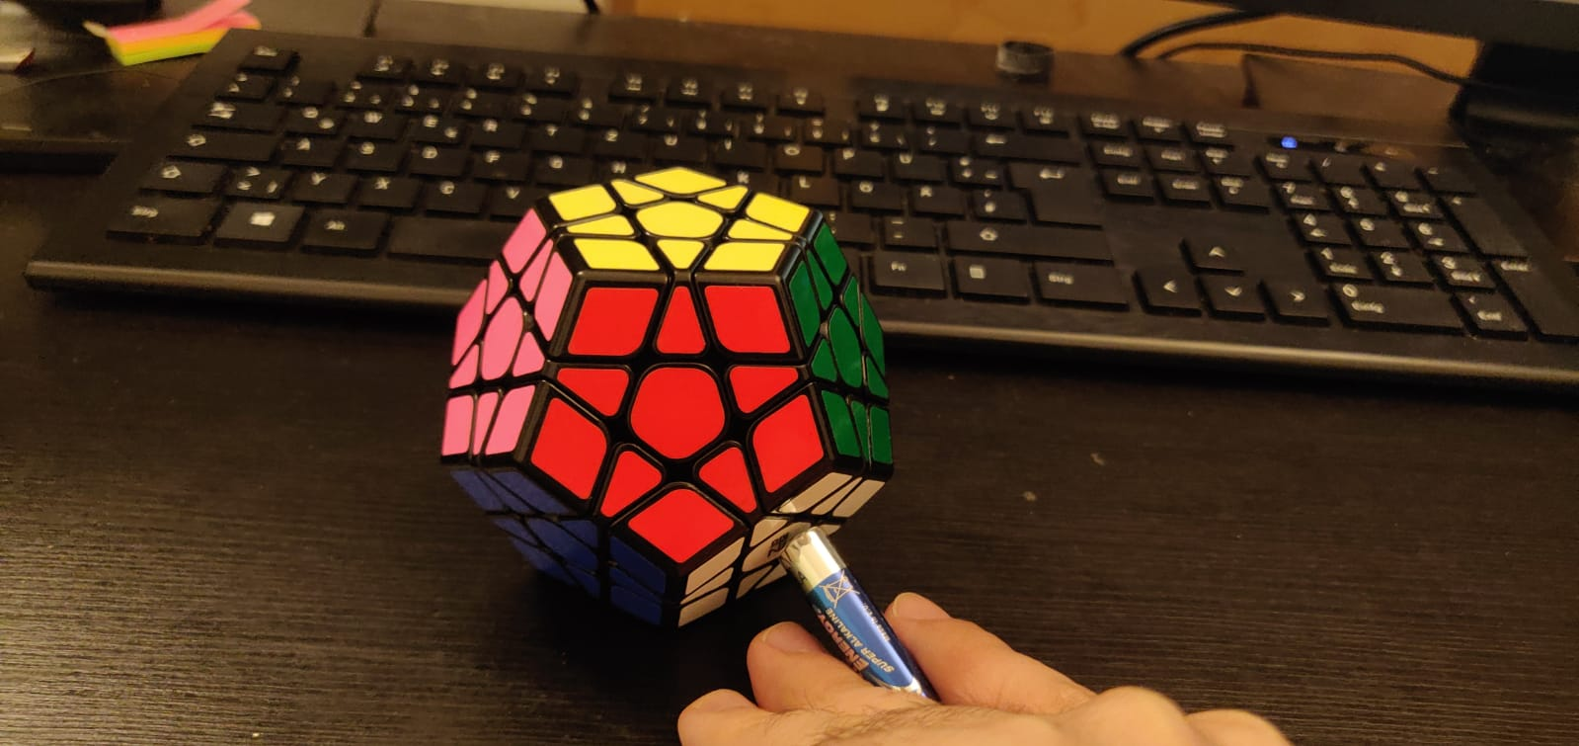
Axis Rotations
r_v
r_dr
r_dl
BACKUP

Slide 45
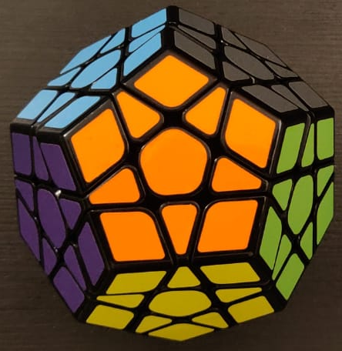
Numeration Method
u
br
bl
l
r
BACKUP
f
b
bdl
bdr
dl
dr
d

